Slide 1


Psychosocial stress-evoked brain and cortisol responses are associated with provoked Th17-related airway inflammation in asthma
Estelle Higgins, William Busse, Stephane Esnault, Danika Klaus, Corinna Frye, Melissa Rosenkranz
Center for Healthy Minds,
University of Wisconsin-Madison, U.S.
PNIRS Annual Meeting 2024

Slide 2
Stress neurocircuitry, cortisol, and provoked Th17-related airway inflammation in asthma
Estelle Higgins, William Busse, Stephane Esnault, Danika Klaus, Corinna Frye, Melissa Rosenkranz
Center for Healthy Minds,
University of Wisconsin-Madison, U.S.
PNIRS Annual Meeting 2024

Slide 3
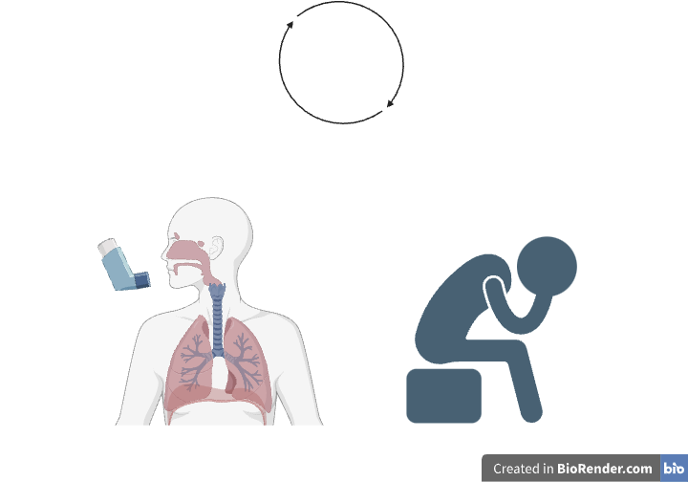
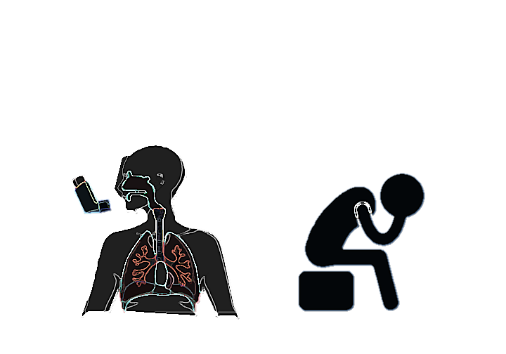
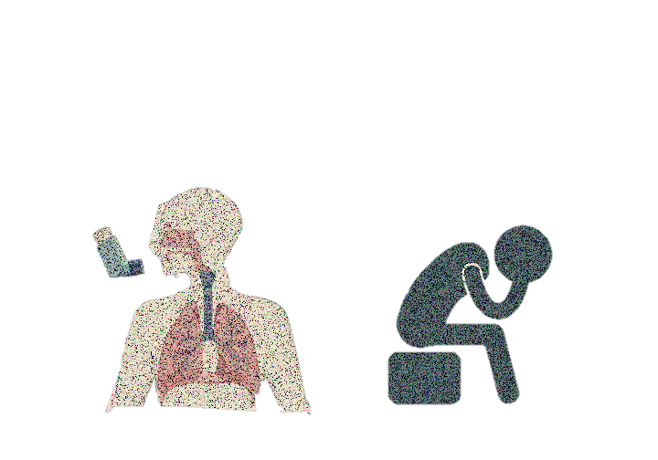
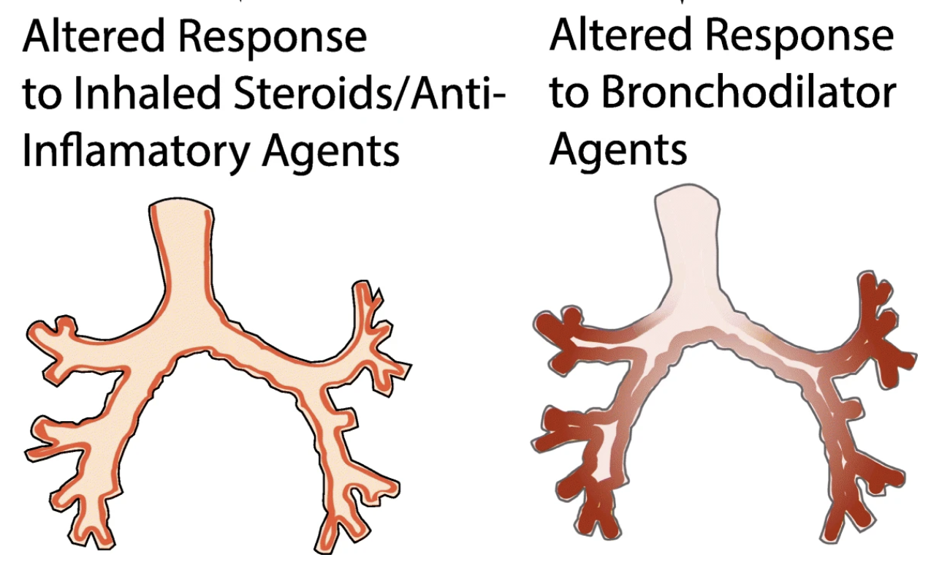
Asthma interacts with the mind
Higher Stress: more severe, poorly-controlled, treatment-resistant asthma
Global Asthma Prevalence: 262 million
~1200 deaths/day
(Vos et al., The Lancet, 2019; McDonald et al., Eur. Resp. J. 2019; Barnthouse & James, Clin Rev Allergy & Immunol, 2019)
Background
Methods
Results
Conclusions
Notes:
- Asthma is a highly prevalent chronic inflammatory disease that results in ~1200 deaths/day.
Asthma also interacts bidirectionally with the mind – today I’m focusing on stress, which is a recognized asthma trigger.
Asthma patients with higher stress have more severe, poorly-controlled, treatment-resistant asthma
This makes asthma a great model for studying interactions between chronic inflammation and stress, and the involvement of the brain
However, the mechanisms of this mind-body link in asthma are relatively unknown (and could impact how we treat asthma)

Slide 4
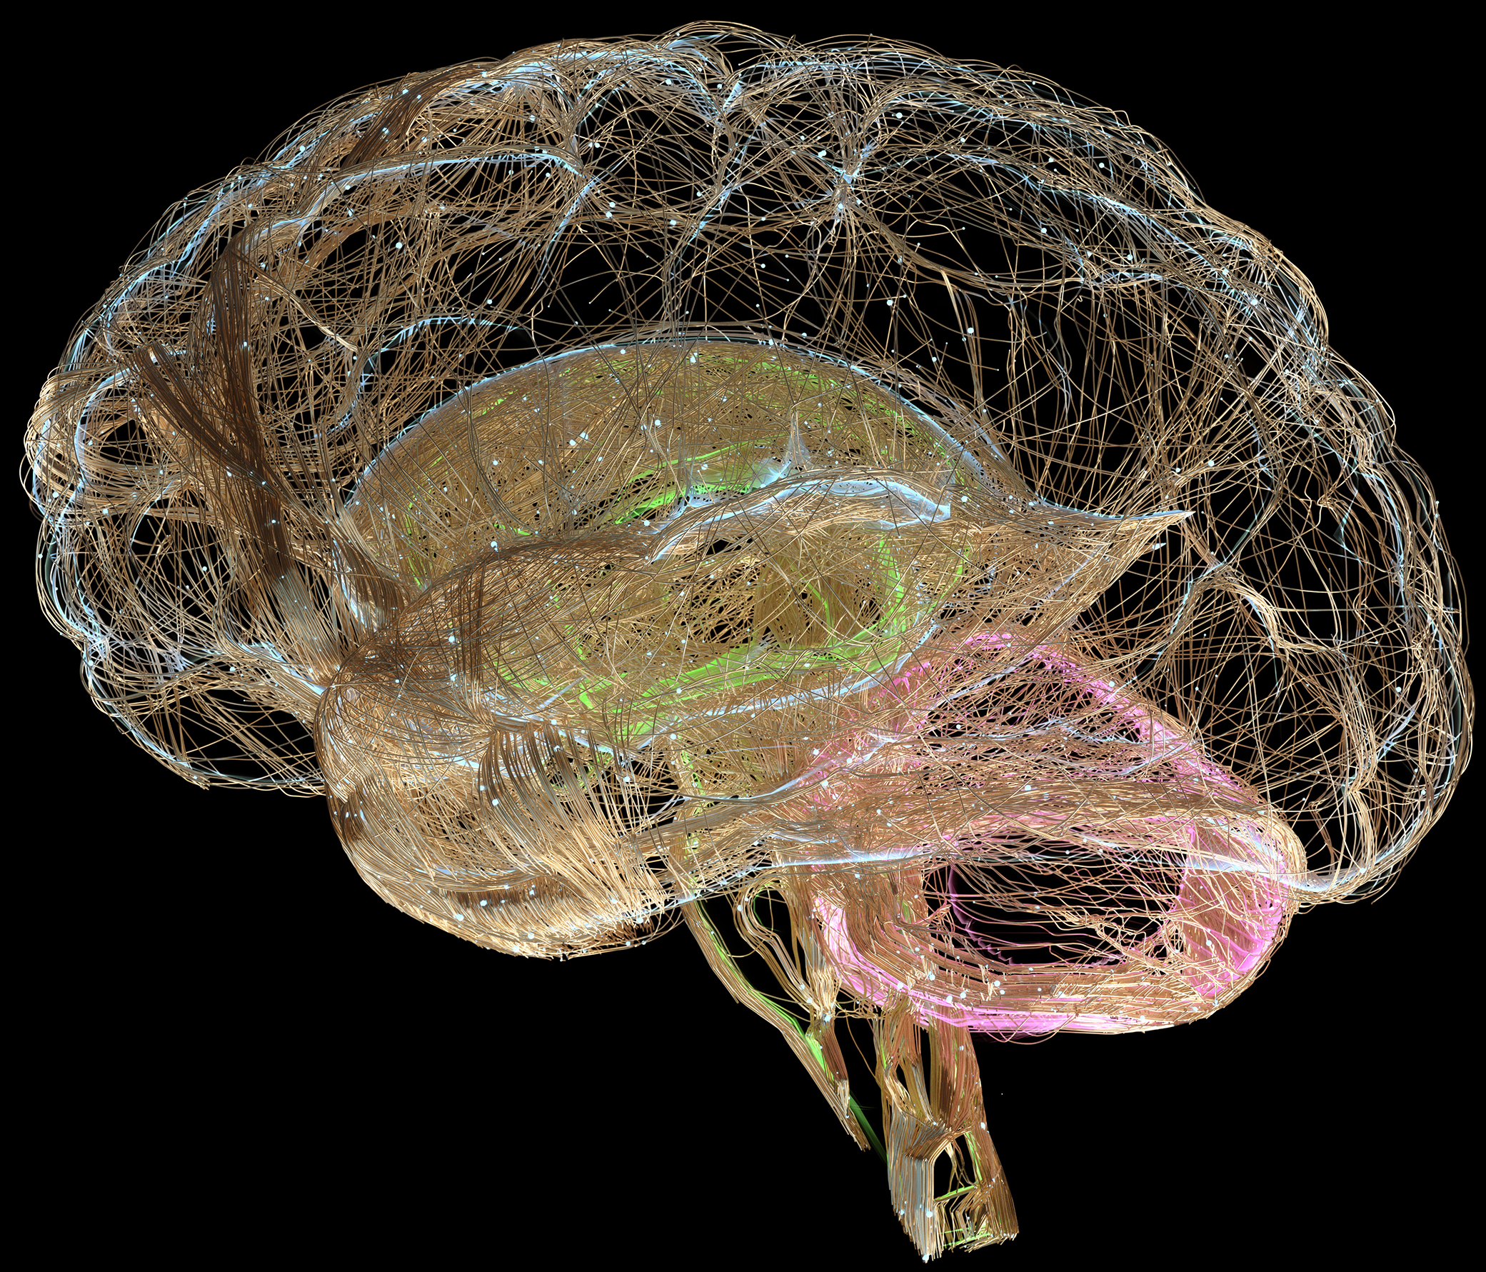

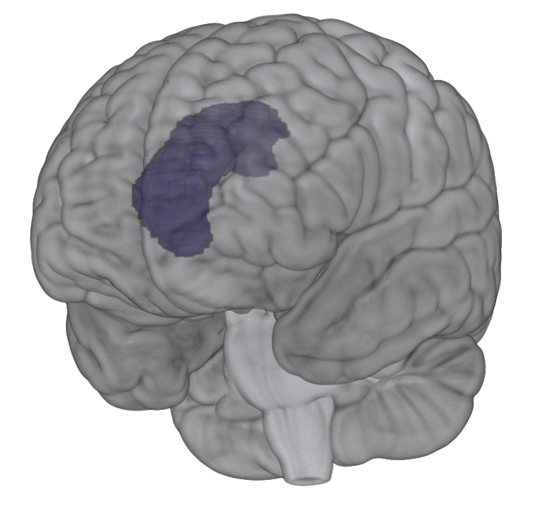
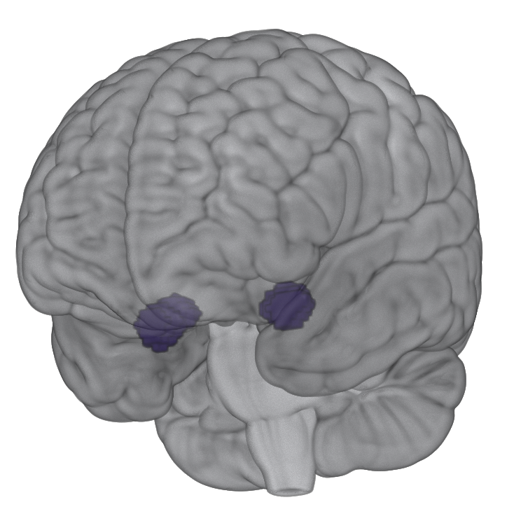
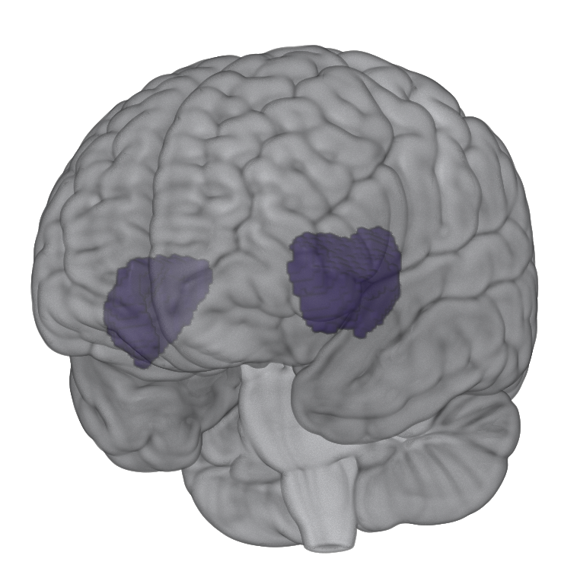
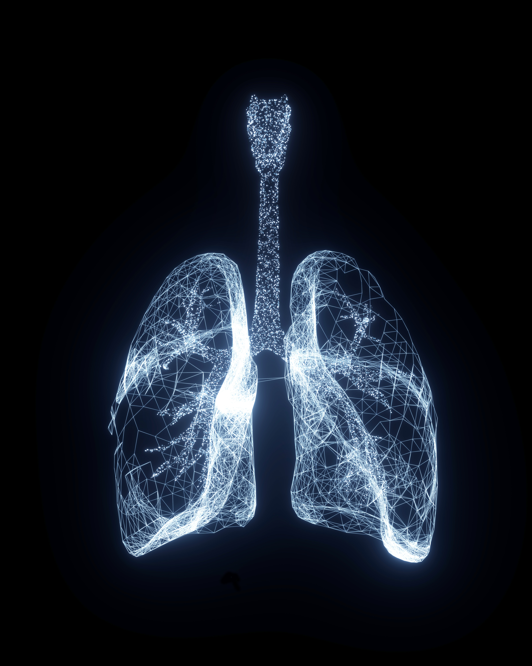
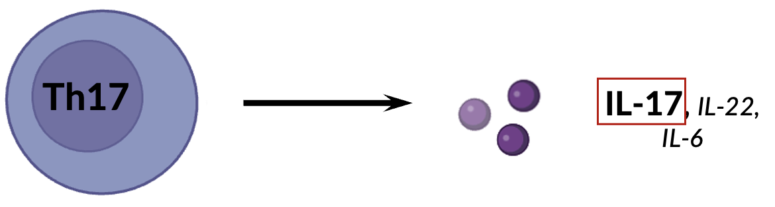
Brain and immune pathways are unknown
Initial evidence:
Stress/emotion neurocircuitry: salience network (Menon, Brain Mapping 2015)
Dorsal Anterior Cingulate Cortex (dACC)
Amygdala
Insula
stress
Immune pathways that trigger asthma symptoms associated with stress (e.g., Th17; Rosenkranz et al., BBI 2016)
Asthma-Related Inflammation
Background
Methods
Results
Conclusions
Notes:
Specifically, (NEXT) which particular brain networks are involved? and (NEXT) which immune pathways are most important in this relationship? (NEXT)
Initial evidence, including work from our lab, points to
Threat and emotion-sensitive neurocircuitry involved in immune processes
Specifically, the set of regions called the Salience Network consists of the dorsal anterior cingulate (dACC), amygdala, and insula These regions are often coactivated and involved in processing, predicting, and responding to salient/threat-related/physio-relevant stimuli,
This network has emerged across many studies as being important in the relationship between emotion and inflammation, including our work looking at relationships between emotion and asthma [NEXT]
additionally, there are immune pathways that trigger asthma symptoms which are ALSO involved in stress, depression, anxiety, such as the Th17 pathway

Slide 5



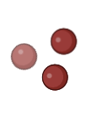





Th2 & Th17-related pathways
T-Helper (Th) Cells
canonical asthmatic airway inflammation, e.g. sputum eosinophils
Th2
IL-4, IL-5, IL-13
Naïve T-Cell
IL-23
Th17
IL-17, IL-22, IL-6
Background
Methods
Results
Conclusions
Notes:
Let’s dive deeper into the immune response: naïve t cells differentiate [next] into several different T-helper cells
Th2 cells drive canonical asthma airway inflammation – for example, the increased expression of sputum eosinophils
Th17-related pathways have different cytokine end products, and importantly
psychological stress reliably increases Th17-related cells; Th17 cytokine administration in animal models induces depressive-like behavior
IL23 is another cytokine that is critical in the expansion, maintenance, and proliferation [NEXT] of Th17 cytokine production
These pathways are synergistic; for example, in asthma eosinophils can increase the production of IL-17.
(remember these players!!)

Slide 6
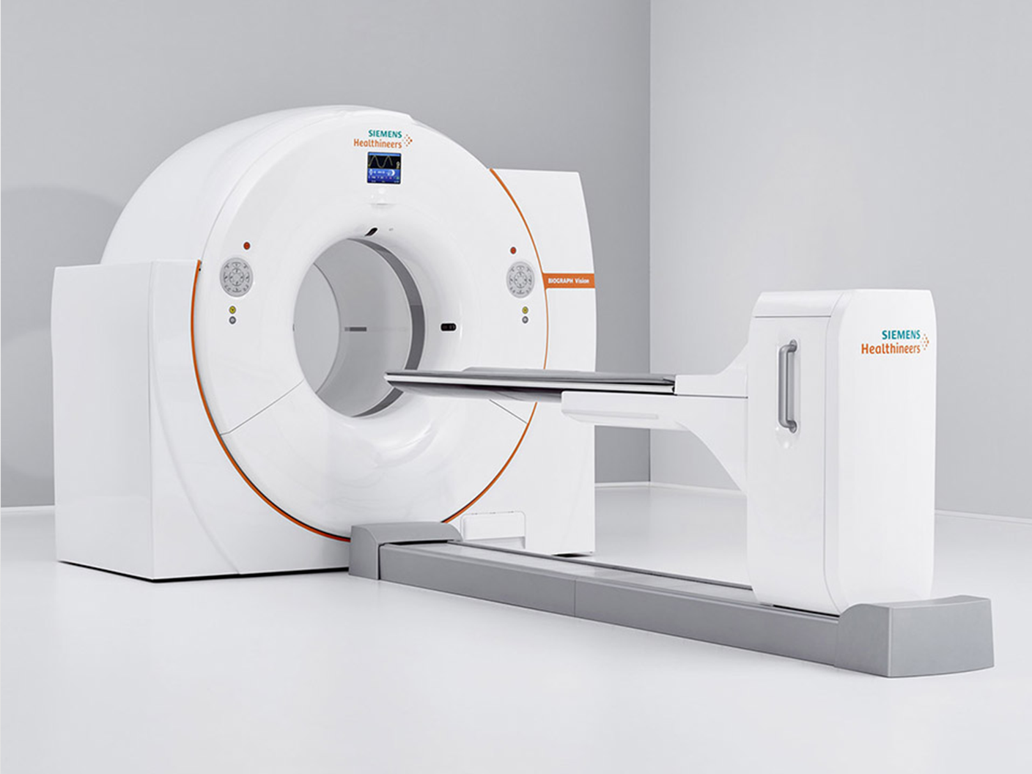



Psychosocial Stressor
Hypothesis: Acute stress will increase provoked
airway inflammation
Threat Neurocircuitry
PET Brain Scan
Allergen Challenge
Efferent (Brain-to-Lung) Mechanisms
Th2 & Th17 Pathways
Asthma-Related Inflammation
Image: https://www.siemens-healthineers.com/en-us/molecular-imaging/pet-ct/biograph-vision
Background
Methods
Results
Conclusions
Notes:
In this work, we hypothesized that: acute stress would increase provoked airway inflammation. We predicted that [next]
A psychosocial stressor would [NEXT] be associated w threat-related neurocircuitry activation (measured by FDG-PET brain scan) [NEXT], which
would influence the production and release of asthma-related immune cells, Th17-related alongside Th2 pathways. [NEXT]
And that this priming would increase susceptibility to an airway allergen challenge; [NEXT]
Causing a more severe inflammatory response after stress compared to after a control condition
Here’s how we measured that

Slide 7

Within-Subjects Design
STRESS Visit
Psychosocial Stress Task
[4wk]
30min
CONTROL Visit
Control Task
30min
Background
Methods
Results
Conclusions
Notes:
participants came for two visits, one with a psychosocial stress task, and one with a non-stressful control
(4+wk apart, order randomized)

Slide 8




Psychosocial Stress or Control Task
Psychosocial Stress or
Control Task
Trier Social Stress Test (TSST)
Control Task
5min
5min
5min
5min
+/-
+/-
Modified
speech
math
speech
math
(Kern et al., PNEC 2008)
Background
Methods
Results
Conclusions
Notes:
The psychosocial stress manipulation in our study was the TSST: a well-validated task that increases physio/psych stress.
Participants perform speech and challenging math tasks in front of a microphone, a camera, and a panel of very unimpressed judges [next]
[next]
Non-stressful control task was identical but with stressful elements removed, so there were no microphones, cameras, or judges, and speech/math were made easier

Slide 9

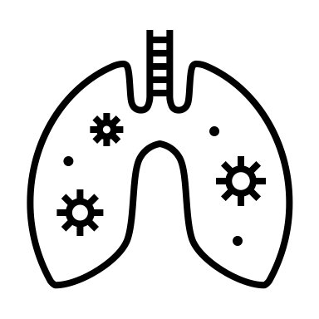
Within-Subjects Design
STRESS Visit
Psychosocial Stress Task
PET Brain Scan
Acute Lung Allergen Challenge
30min
30min
4hr
[4wk]
Salivary Cortisol Collected every ~10min
Th2 & Th17 Airway Inflammation hourly
CONTROL Visit
Control Task
30min
Background
Methods
Results
Conclusions
Notes:
After the psychosocial stress or control task, participants had a [NEXT] PET brain scan using radiolabeled glucose to measure regional glucose metabolism to show where the brain was active during the task
(NEXT) To measure physio stress responses, We collected salivary cortisol about every 10min during the stress and control tasks and brain scans.
Then participants were given an acute lung allergen challenge, and we measured lung function and airway inflammation in both Th2 and Th17 pathways FROM THE LUNG [NEXT] before and hourly for 4hr after
Sputum = nebulized saline inhaled then cough up phlegm
[NEXT]

Slide 10
Within-Subjects Design
STRESS Visit
Psychosocial Stress Task
PET Brain Scan
Acute Lung Allergen Challenge
30min
30min
4hr
[4wk]
Salivary Cortisol Collected every ~10min
Th2 & Th17 Airway Inflammation hourly
CONTROL Visit
Control Task
PET Brain Scan
Acute Lung Allergen Challenge
30min
30min
4hr
Salivary Cortisol Collected every ~10min
Th2 & Th17 Airway Inflammation hourly
Background
Methods
Results
Conclusions
Notes:
Again participants came for two visits, one with the stress task, one with the control (allergen challenge every time)
With this within-subj design, we were able to look at what was different WITHIN each participant, between stress and control conditions

Slide 11
Participants
n = 28 (18 F)
Adults ages 19-45y (Mean 25.9y)
Mild asthma; no corticosteroid medications
89% White Non-Hispanic
n = 25 White, n = 1 Black/African American, n = 1 Asian, n = 1 multi-racial
Background
Methods
Results
Conclusions
Notes:
Our participants were 28 adults ages 19-45y, majority female, with physician-diagnosed mild asthma, who were not taking inhaled corticosteroid meds
89% identified as White Non-Hispanic [NEXT]
(limited psychotropic including anti-anxiety/depr included)
Let’s turn to results

Slide 12
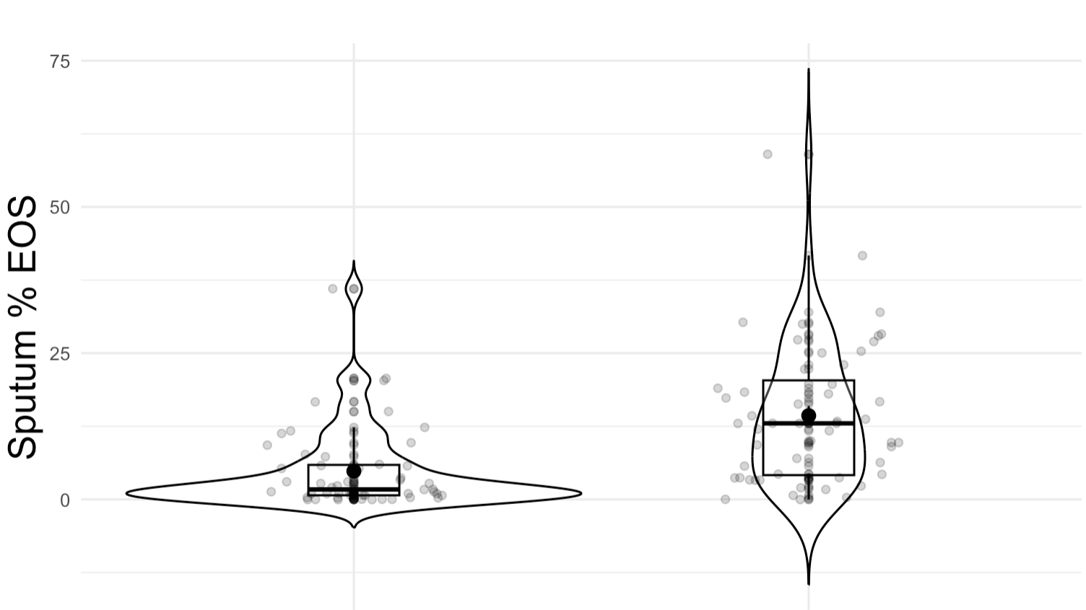
Does allergen challenge increase inflammation?
Allergen challenge increases airway inflammation
Stats:
t(23) = 10.37,
p < .001
Before Allergen Challenge After Allergen Challenge
Background
Methods
Results
Conclusions
Notes:
First, the allergen challenge was effective: airway inflammation significantly increased for all inflammatory markers in all participants after allergen challenge – whether it was after the stress condition or after the control condition

Slide 13
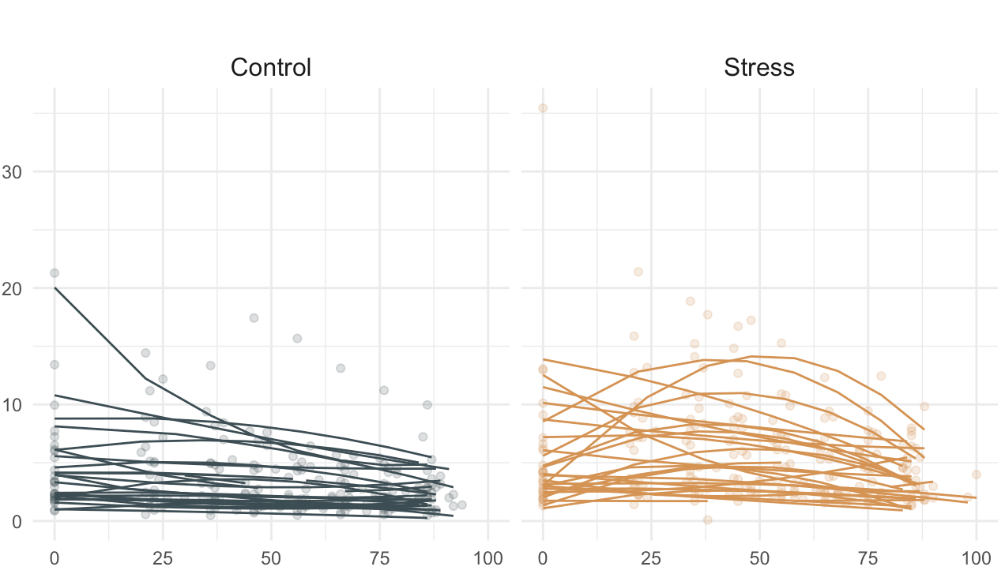
Does acute stress cause a stress response?
Acute psychosocial stress increases cortisol
Cortisol (nmol/L)
Stats:
t(24.7) = -3.46,
p = .002
Minutes Since Start of Stress/Control Task
Background
Methods
Results
Conclusions
Notes:
Similarly, validating the stress manipulation, acute stress increased cortisol, invoking a physiological stress response

Slide 14
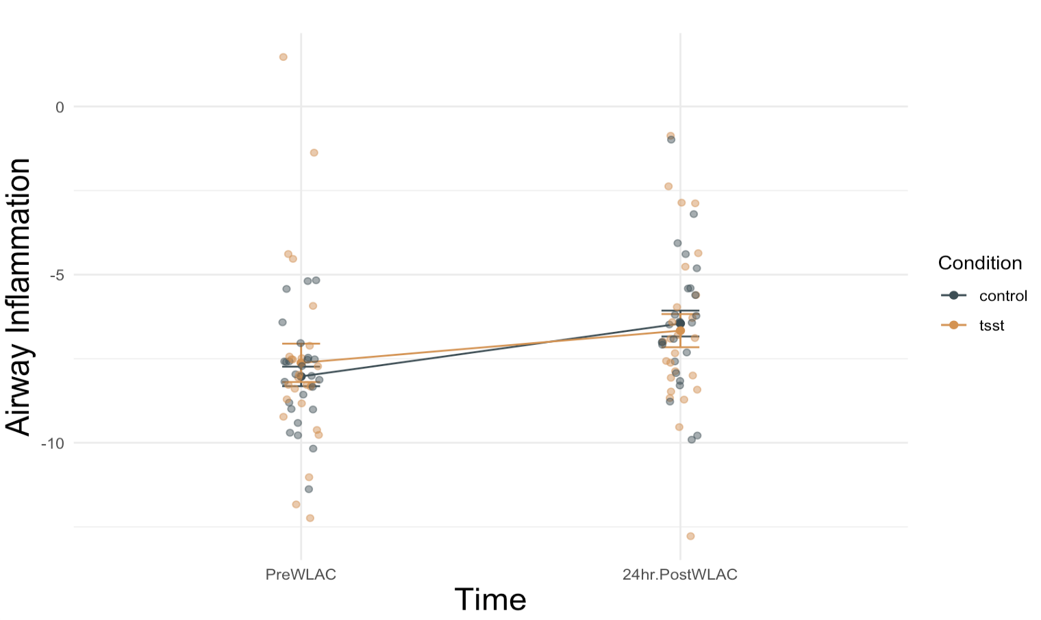
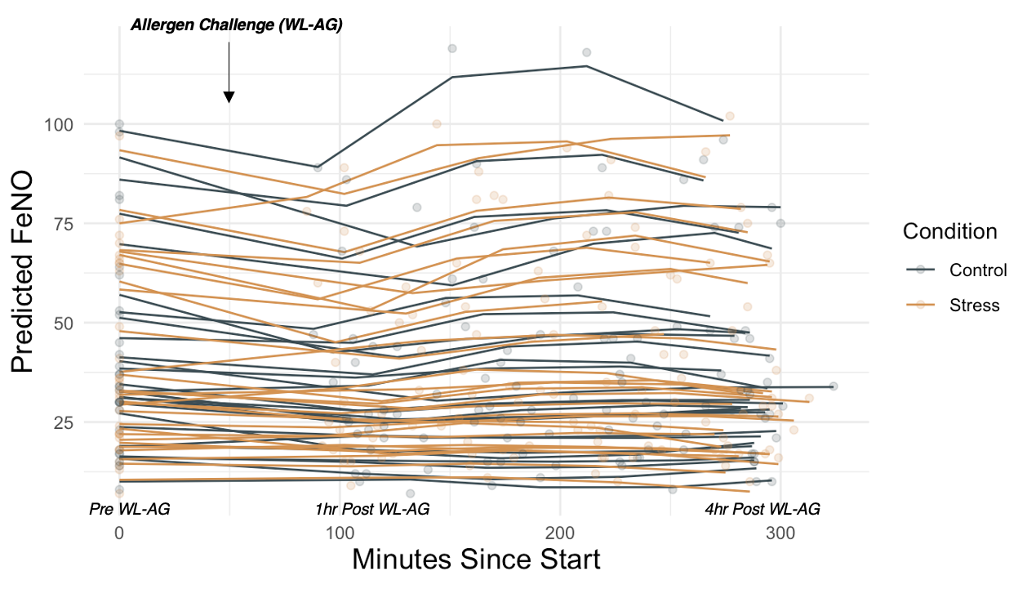
Does acute stress increase inflammation?
Acute psychosocial stress does not significantly increase airway inflammation
Airway Inflammation
Stats (condition difference):
t(25) = 0.08,
p = .805
Before Allergen Challenge After Allergen Challenge
Background
Methods
Results
Conclusions
Notes:
Interestingly, this effect of stress was not borne out in inflammatory response as a whole group
Contrary to our predictions, acute stress did not significantly increase airway inflammation.
Though Inflammation increased pre- to post-challenge, there wasn’t a significant difference after stress compared to after control.
So, the story seems to be more complex: and indeed, the differences emerge when we consider how reactive individuals were to stress

Slide 15

Does acute stress increase inflammation?
Acute psychosocial stress does not significantly increase airway inflammation
Airway Inflammation
Stats (condition difference):
t(25) = 0.08,
p = .805
Before Allergen Challenge After Allergen Challenge
Background
Methods
Results
Conclusions
Notes:
Interestingly, this effect of stress was not borne out in inflammatory response as a whole group
Contrary to our predictions, acute stress did not significantly increase airway inflammation. Though Inflammation increased pre- to post-challenge, there wasn’t a significant difference after stress compared to after control.
So, the story seems to be more complex: and indeed, the differences emerge when we consider how reactive individuals were to stress

Slide 16
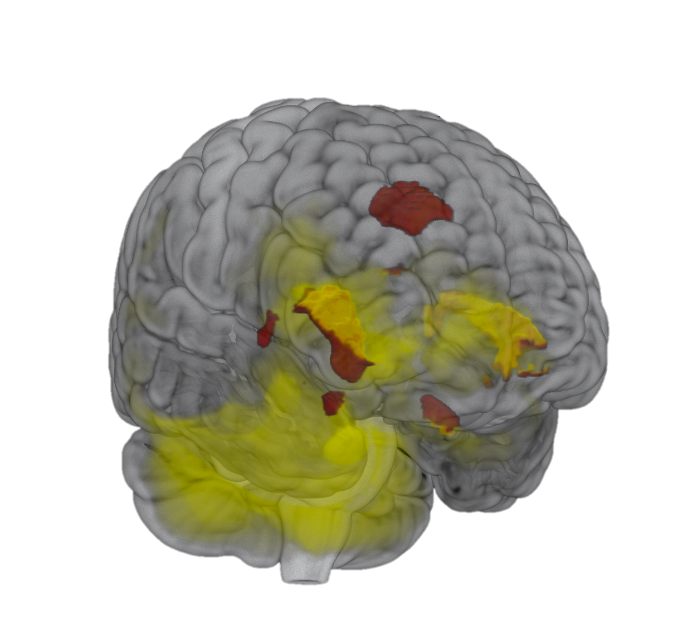
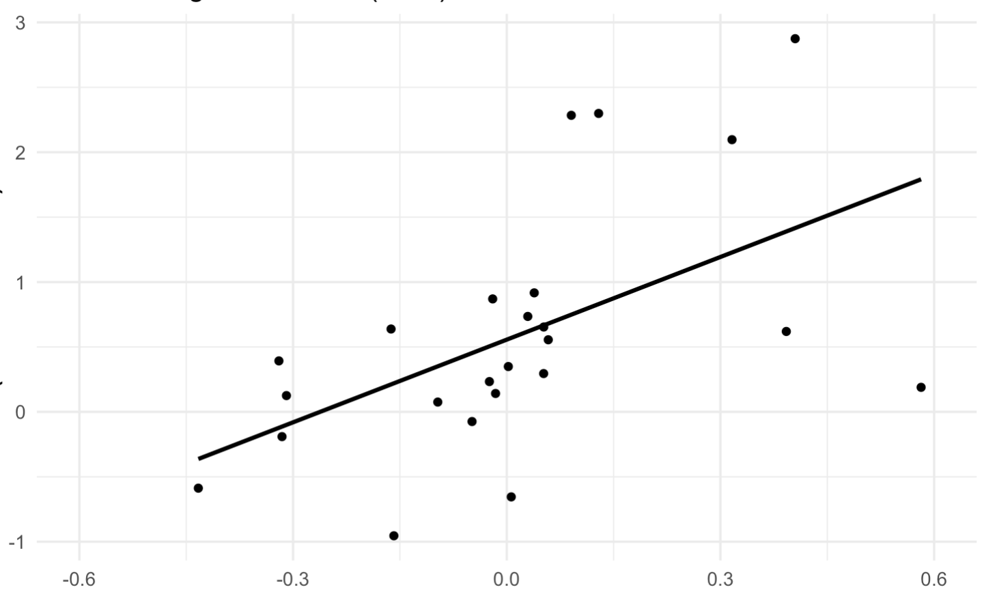
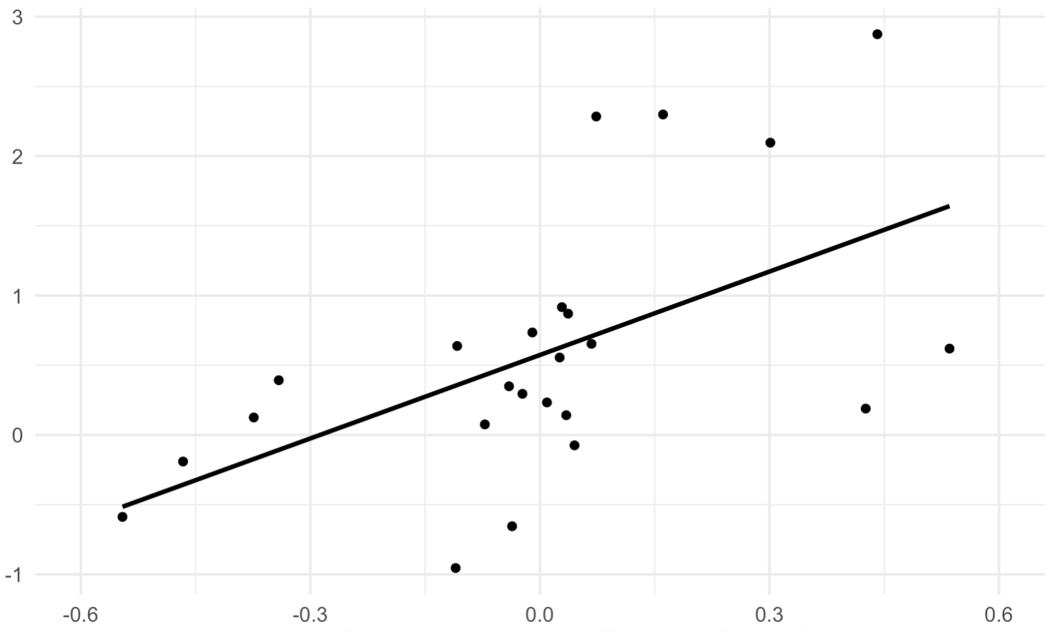
Cortisol response to psychosocial stress is associated with widespread brain activation
How are brain responses related to physiological responses to stress?
Dorsal Anterior Cingulate Cortex (dACC)
Insula
Saliva Cortisol AUC (nmol/L)
(Stress > Control)
stress > control & greater cortisol response
local Salience Network peaks
Mean Glucose Metabolism (Stress > Control)
Background
Methods
Results
Conclusions
Notes:
The differences emerge when we consider how reactive individuals were to stress
we found that those w more robust cortisol responses to stress had greater brain activation throughout the brain, including in threat-sensitive salience network regions, which are highlighted in red
We’re looking at regions where glucose metabolism, indexing brain activity, was greater during stress for those participants who had greater cortisol responses
[NEXT]
The plot shows this positive correlation for the insula, dACC …
Yellow = all voxels showing significant pos corr w magnitude of stress-evoked cortisol

Slide 17

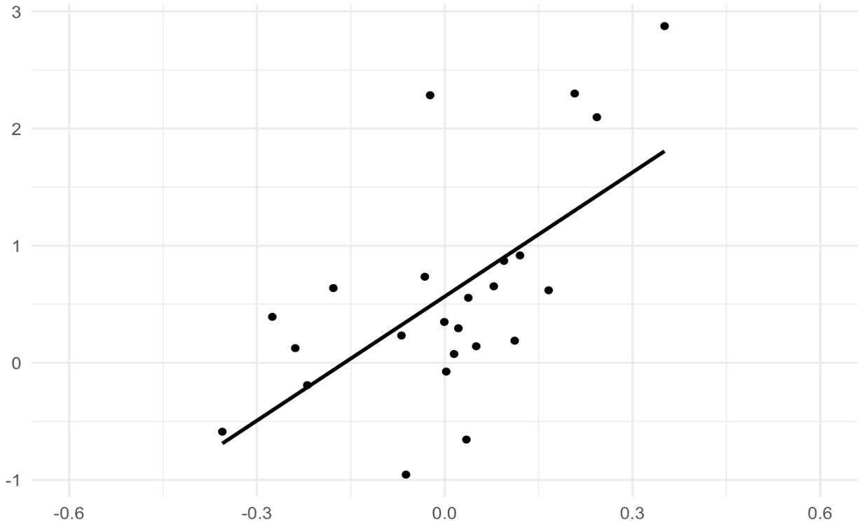
Cortisol response to psychosocial stress is associated with widespread brain activation
How are brain responses related to physiological responses to stress?
Right Amygdala
Saliva Cortisol AUC (nmol/L)
(Stress > Control)
stress > control & greater cortisol response
local Salience Network peaks
Mean Glucose Metabolism (Stress > Control)
Background
Methods
Results
Conclusions
Notes:
And amygdala

Slide 18
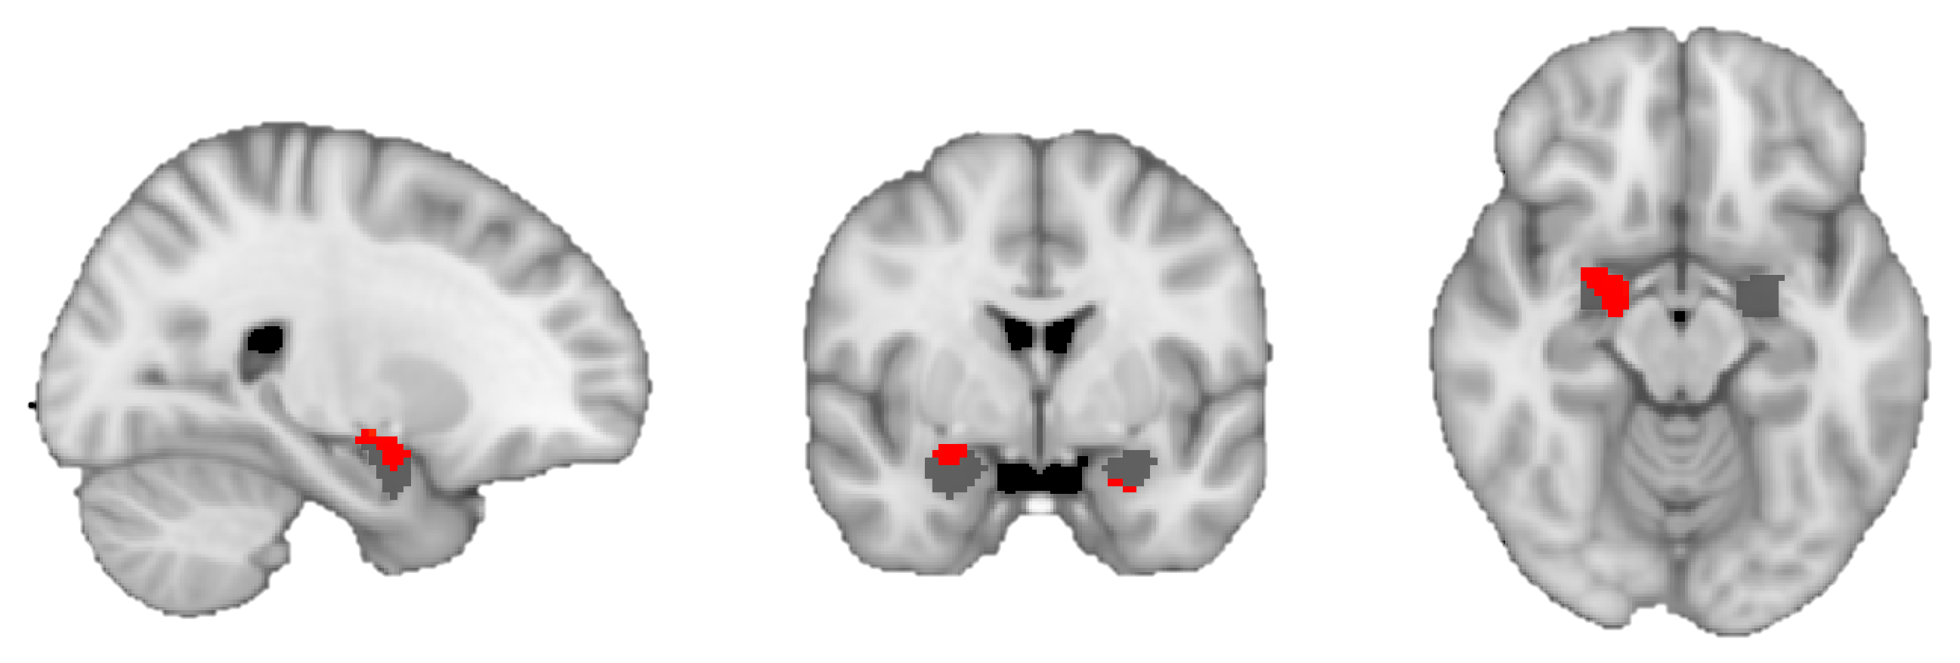
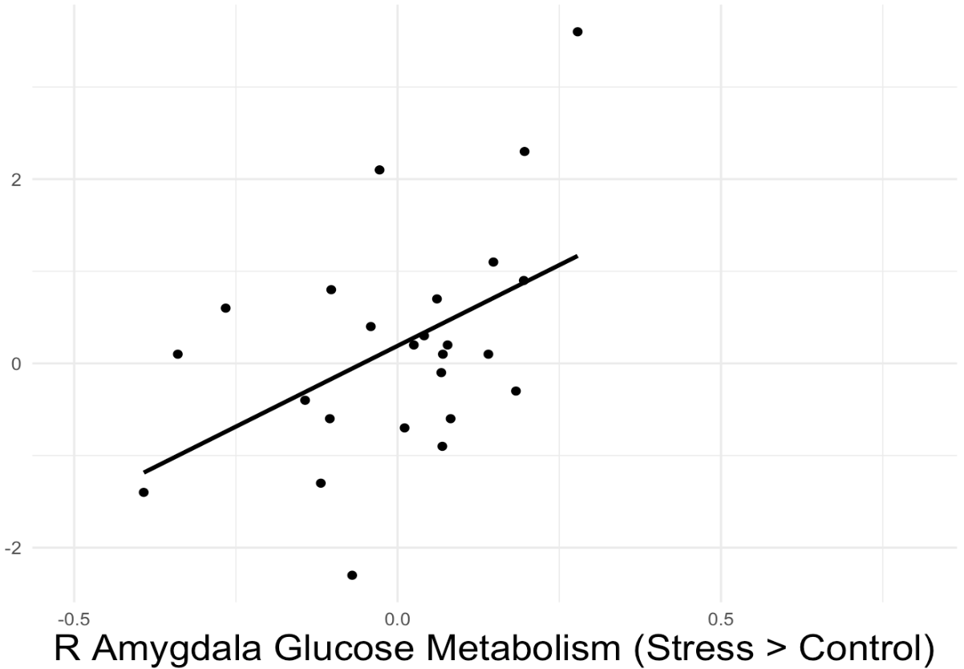
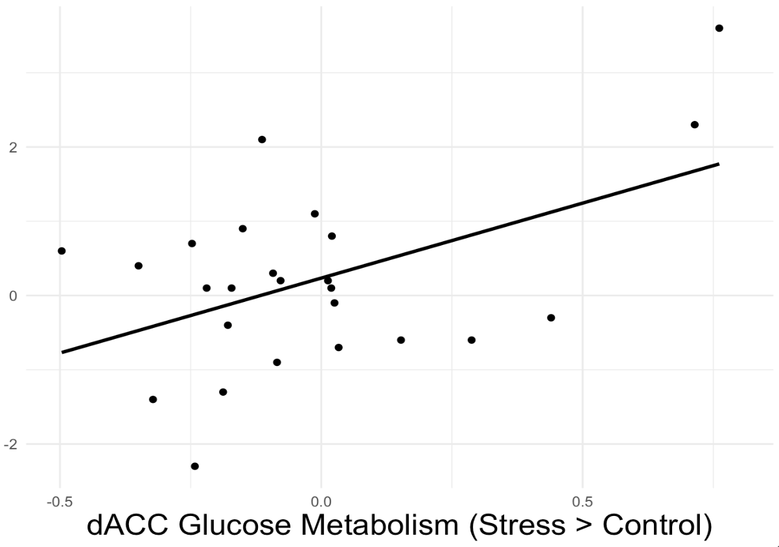
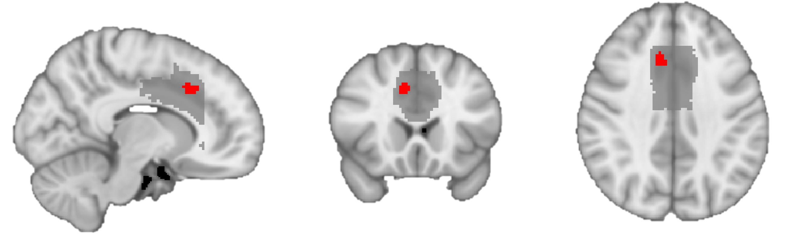
Stress-related salience network activity predicts airway IL-23A mRNA expression
Do brain responses predict inflammatory responses?
Amygdala
Right Amygdala
Dorsal Anterior Cingulate Cortex (dACC)
R
R
L
R
L
IL-23A Fold Increase (Stress > Control)
Dorsal Anterior Cingulate Cortex (dACC)
R
R
L
R
L
Mean Glucose Metabolism (Stress > Control)
p < .05 corrected
Background
Methods
Results
Conclusions
Notes:
Supporting our central hypothesis, stress-related Salience Network activity predicted greater IL-23A mRNA expression following airway challenge –
:: in other words, participants who showed this pattern of neural responses to stress also had increased airway inflammation in response to the allergen challenge
red are the voxels where brain activity was significantly greater in stress relative to control which also predicted airway inflammation [NEXT]
The plot shows this positive correlation, in the amygdala [NEXT] and the dACC

Slide 19
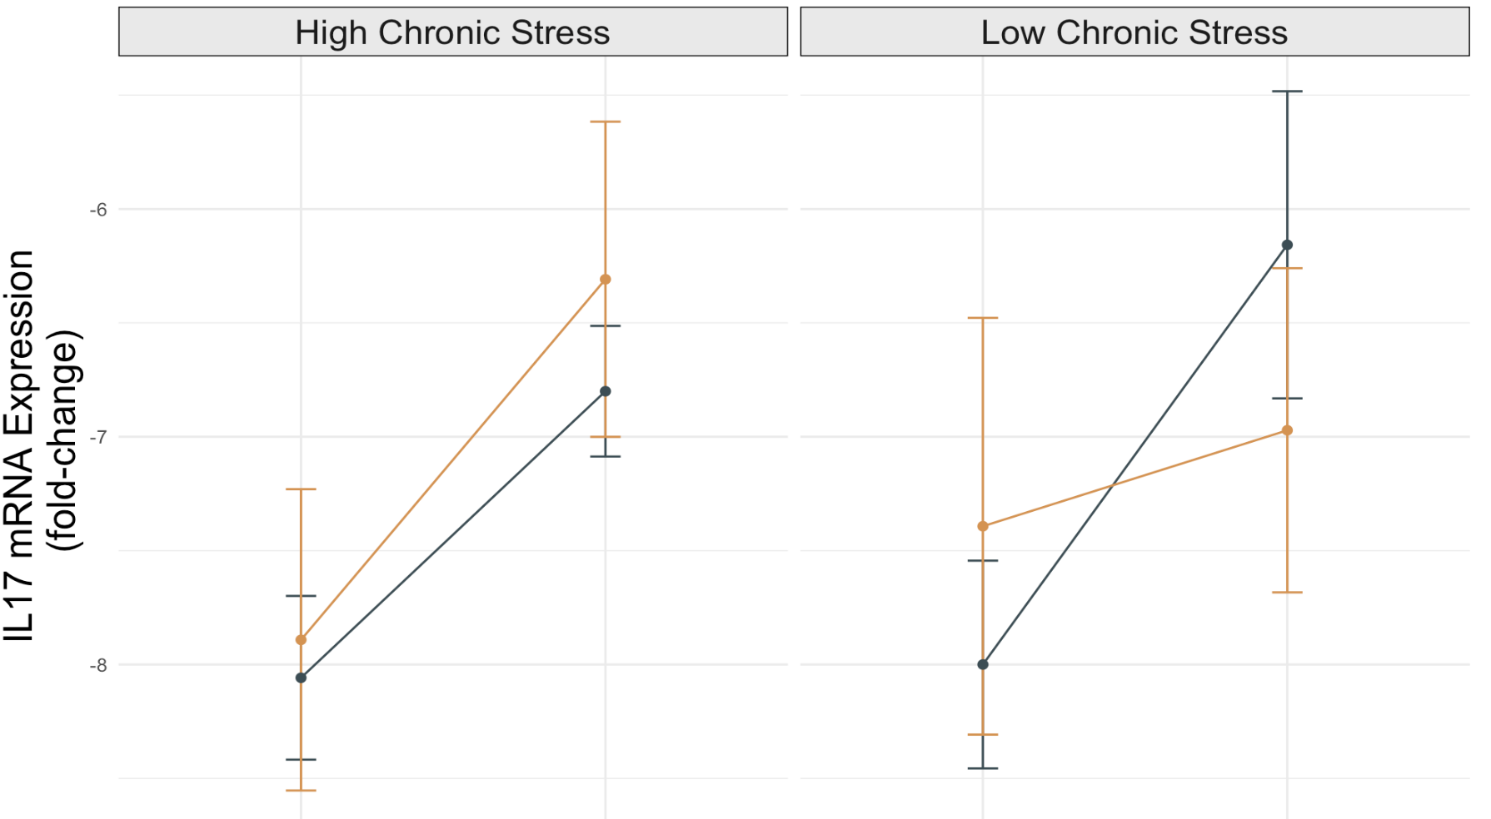
Chronic stress enhances effects of acute psychosocial stress on IL-17A mRNA expression
Does inflammation response vary with chronic stress?
Before
Allergen Challenge
After
Allergen Challenge
Before
Allergen Challenge
After
Allergen Challenge
Background
Methods
Results
Conclusions
Notes:
Finally, chronic stress enhanced effects of psychosocial stress on IL-17A mRNA expression in the airways
We assessed chronic stress at baseline using the UCLA Life Stress Interview, which is a semi-structured interview assessing personal and social functioning
Participants with higher levels of chronic stress showed potentiation of IL-17A mRNA expression following acute stress, whereas this IL17 response appeared to be blunted by the TSST for those with lower chronic stress;
This aligns with literature showing that chronic exposure to stress hormones can decrease the sensitivity of immune cells to the anti-inflammatory properties of stress hormones
DID NOT MEDIAN SPLIT, analyzed as continuous

Slide 20


Main Takeaway
Psychosocial Stressor
Individual differences in acute stress response impact Th17-related inflammation
Threat Neurocircuitry
Cortisol
Chronic Stress
Allergen Challenge
Th17-Related Airway Inflammation
Background
Methods
Results
Conclusions
Notes:
THE MAIN TAKEAWAY IS: individual differences in acute stress responses impact Th17-related inflammation in asthma
Although psychosocial stress did not increase inflammatory responses as a whole group; [NEXT]
variability in stress responses impacted inflammation :
more robust neural and cortisol responses to stress were associated w stronger Th17 inflammatory responses,
As was higher chronic life stress
Stress-related salience network activation may therefore enhance Th17 inflammatory potential in asthma
[suggests that those DON’T respond as much to acute stress don’t show as much inflammatory response]
HPA as a mechanism connecting brain to inflammatory responses?
… and that the impacts of asthma may extend beyond just a disease of the airways?

Slide 21

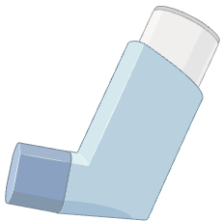

Need for integrative treatment and prevention in asthma
individual differences in airway disease
pulmonary (Th17) and extra-pulmonary (stress) processes
stress-reduction interventions
corticosteroid alternatives
e.g., mindfulness (Higgins et al., BBI-Health 2022)
Background
Methods
Results
Conclusions
Notes:
This matters in the broader context! there is a need for more integrative treatment and prevention approaches in asthma, bc current treatments are based on symptoms rather than underlying biology and rarely consider factors beyond the airways [NEXT]
For instance, this work suggests that corticosteroids, a current front-line anti-inflammatory treatment, may be less effective for those with greater stress reactivity or higher chronic stress… alternatives may be needed [NEXT]
Similarly, our results suggest that reducing stress and its effects may be useful for preventing worse airway inflammation for some
in fact, we have shown that mindfulness-based stress reduction can impact the relationships between psych symp and airway inflammation!
This work provides a motivation & foundation for future research to develop interventions tailored to individual diffs in airway disease [next], targeting both pulmonary (e.g., Th17-related paths) and extrapulmonary (e.g., stress-related) processes in airway diseases
Neuro target for behavioral strategies?

Slide 22










Gratitude
William Busse, PhD
Melissa Rosenkranz, PhD
Richard Davidson, PhD
Corinna Frye
Stephane Esnault, PhD
John Curtin, PhD
Danika Klaus, RN
…and many more!
Work supported by NHLBI (R01 HL123284)
Lyn Abramson, PhD
Notes:
Thank you to the extraordinary team that made this work possible! 🙂

Slide 23
References
Barnthouse, M., & Jones, B. L. (2019). The Impact of Environmental Chronic and Toxic Stress on Asthma. Clinical Reviews in Allergy & Immunology, 57(3), 427–438. https://doi.org/10.1007/s12016-019-08736-x
Impact and Management of Asthma and Anxiety and Depression. (2019, September 19). Severe Asthma Toolkit. https://toolkit.severeasthma.org.au/co-morbidities/extra-pulmonary/anxiety-depression/
Higgins, E. T., Davidson, R. J., Busse, W. W., Klaus, D. R., Bednarek, G. T., Goldman, R. I., Sachs, J., & Rosenkranz, M. A. (2022). Clinically relevant effects of Mindfulness-Based Stress Reduction in individuals with asthma. Brain, Behavior, & Immunity - Health, 25, 100509. https://doi.org/10.1016/j.bbih.2022.100509
Kern, S., Oakes, T. R., Stone, C. K., McAuliff, E. M., Kirschbaum, C., & Davidson, R. J. (2008). Glucose metabolic changes in the prefrontal cortex are associated with HPA axis response to a psychosocial stressor. Psychoneuroendocrinology, 33(4), 517–529. https://doi.org/10.1016/j.psyneuen.2008.01.010
McDonald, V. M., Clark, V. L., Cordova-Rivera, L., Wark, P. A. B., Baines, K. J., & Gibson, P. G. (2020). Targeting treatable traits in severe asthma: A randomised controlled trial. European Respiratory Journal, 55(3). https://doi.org/10.1183/13993003.01509-2019
Menon, V. (2015). Salience Network. In Brain Mapping (pp. 597–611). Elsevier. https://doi.org/10.1016/B978-0-12-397025-1.00052-X
Rosenkranz, M. A., Esnault, S., Christian, B. T., Crisafi, G., Gresham, L. K., Higgins, A. T., Moore, M. N., Moore, S. M., Weng, H. Y., Salk, R. H., Busse, W. W., & Davidson, R. J. (2016). Mind-body interactions in the regulation of airway inflammation in asthma: A PET study of acute and chronic stress. Brain, Behavior, and Immunity, 58, 18–30. https://doi.org/10.1016/j.bbi.2016.03.024
Vos, T., Lim, S. S., Abbafati, C., Abbas, K. M., Abbasi, M., Abbasifard, M., Abbasi-Kangevari, M., Abbastabar, H., Abd-Allah, F., Abdelalim, A., Abdollahi, M., Abdollahpour, I., Abolhassani, H., Aboyans, V., Abrams, E. M., Abreu, L. G., Abrigo, M. R. M., Abu-Raddad, L. J., Abushouk, A. I., … Murray, C. J. L. (2020). Global burden of 369 diseases and injuries in 204 countries and territories, 1990–2019: A systematic analysis for the Global Burden of Disease Study 2019. The Lancet, 396(10258), 1204–1222. https://doi.org/10.1016/S0140-6736(20)30925-9

Slide 24
THANK YOU! Estelle Higgins, M.S. Psychology PhD student at the University of Wisconsin-Madison Email: higgins5@wisc.edu
Notes:
IL-17 and IL-23 can increase glucocorticoid receptor-β expression, which has been linked to steroid resistance in adults with asthma
GR-b interacts w DNA but not corticosteroids
MBSR: those on steroids with high inflammation, indicating steroids weren’t working for them, respond to MBSR
Racial/ethnic homogeneity: Mostly White-identifying (~90%), 2 Black/African American, 2 multiracial, 1 Asian
My findings may have limited generalizability due to this demographic gap. This is particularly relevant because asthma disproportionately affects individuals identifying as Black NH, American Indian NH, and Multiracial NH ( CDC, 2023). The applicability of my relationships beyond this sample’s specific demographic may require further investigation.
this sample had a MUCH less robust response to acute stress (cortisol comparison) – ecological validity of stressor and variability in what ppl find stressful; also think about perceived threat individual variability
SNS responses we didn’t measure could have moderating influences
Depression: not a depressed sample, but there was a good amount of variability (almost half had clinically significant mild-severe depr)
Stress responses, including increased cortisol expression, impact asthma in part by altering glucocorticoid and adrenergic receptor expression, leading to altered airway responses to anti-inflammatory and bronchodilator treatments
sex: more prevalent in M until adolescence then F ~~~ related to depression??
Age: avg age of asthma onset was 10y; asthma often a childhood disease//effects may start accumulating early, indeed Claire’s work w the ABCD dataset
BRAIN: measuring these inflammatory cytokines/mRNA in the airways, what abt neuroinflammation?

Slide 25
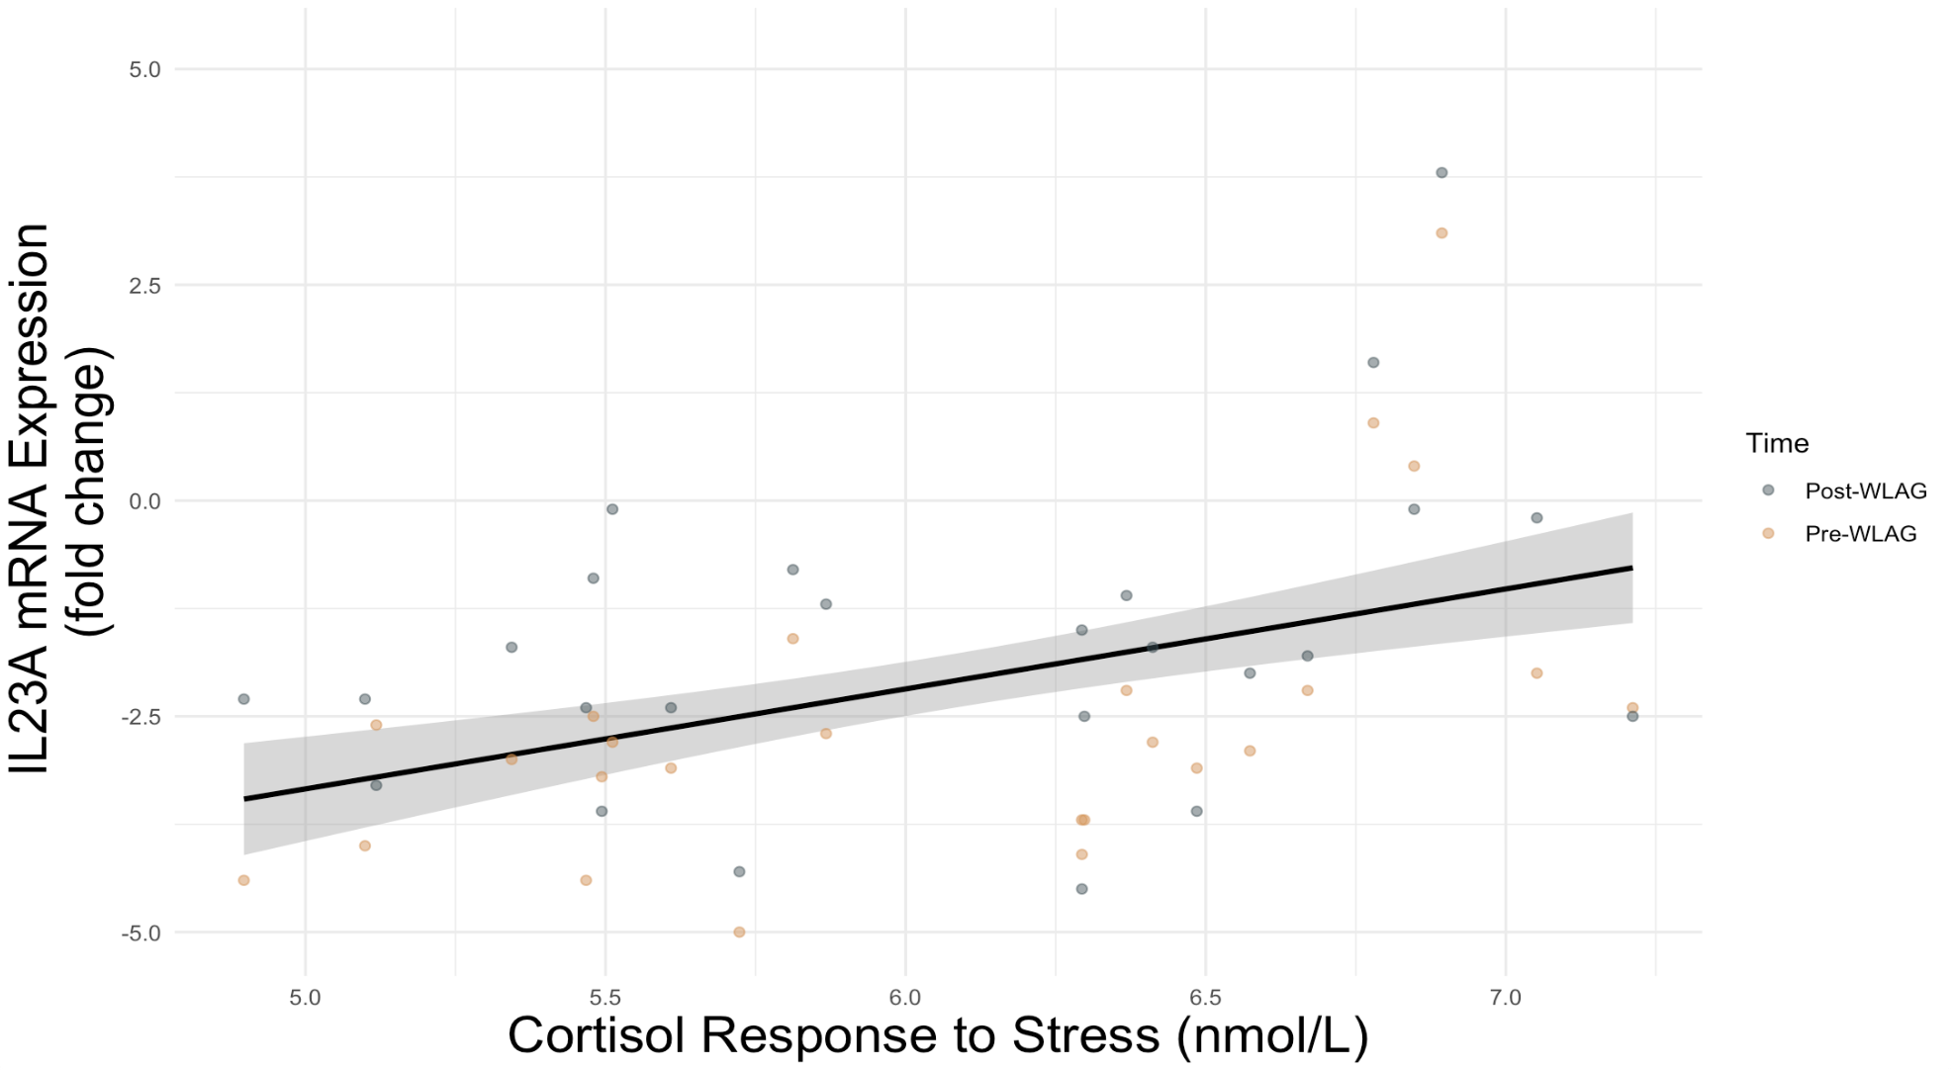
Psychosocial stress-induced cortisol correlates with airway IL-23A mRNA expression
Does inflammation vary with cortisol responses to stress?
Before Allergen Challenge
After Allergen Challenge
Stats
t(22.1) = 2.38, p = .003
Background
Methods
Results
Conclusions
Notes:
Tying these results together, we also found that stress-induced cortisol correlated with IL-23A mRNA expression in the airways
those who had a greater cortisol response in the stress condition, also showed more inflammation in the airways after the stress condition, suggesting a stress-related facilitation of airway inflammation
Interesting bc Corticosteroids are a first line of treatment for inflammatory asthma… Suggests something about who those treatments may not be helpful for
some evidence that HPA axis changes are independent of medication use?
=> Given that salience network regions correlate with stress, inflammatory responses, and physio responses;;; HPA axis stress reactivity appears to link threat-sensitive salience network activity with Th17-related inflammation, in a context of acute stress

Slide 26
THIS IS IMPORTANT: We wouldn’t understand this phenotypic variability without understanding these underlying neural and physiological mechanisms !!!

Slide 27
highlight 1) the importance of threat-sensitive neural circuits and 2) the predominance of Th17 pathways in stress-related potentiation of airway inflammation
those who had larger cortisol responses to the TSST also had greater levels of FeNO and IL-23A mRNA expression. This differential responsiveness was also evident in the brain, where the cortisol response to stress, compared to control, predicted increased glucose metabolism in the amygdala and dACC (in addition to other regions), which in turn was related to greater IL23A expression fol
Stress-related salience network activation may therefore enhance Th17 inflammatory potential in asthma, through the upregulation of IL-23A.

Slide 28
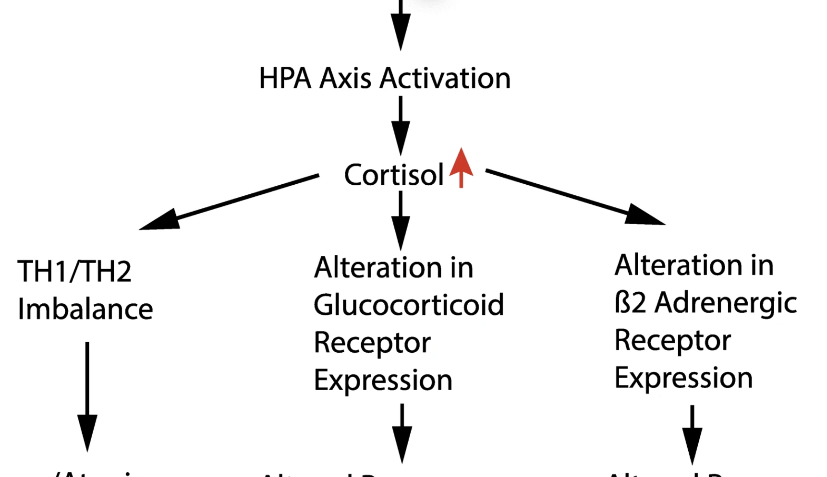
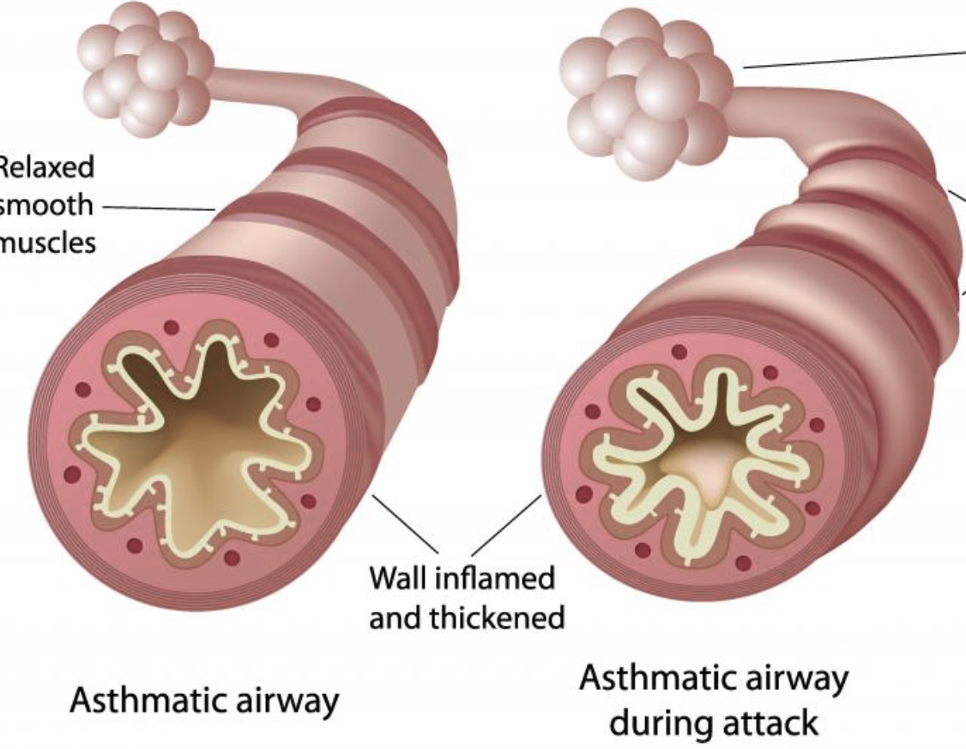

Changes in glucocorticoid receptor expression
Changes in adrenergic receptor expression
Altered response to inhaled steroids/ anti-inflammatory treatments
Altered response to bronchodilators
Notes:
Stress responses, including increased cortisol expression, impact asthma in part by altering glucocorticoid and adrenergic receptor expression, leading to altered airway responses to anti-inflammatory and bronchodilator treatments
Barnthouse & Jones (https://link.springer.com/article/10.1007/s12016-019-08736-x) 2019 Clin Rev Allergy & Immunol

Slide 29
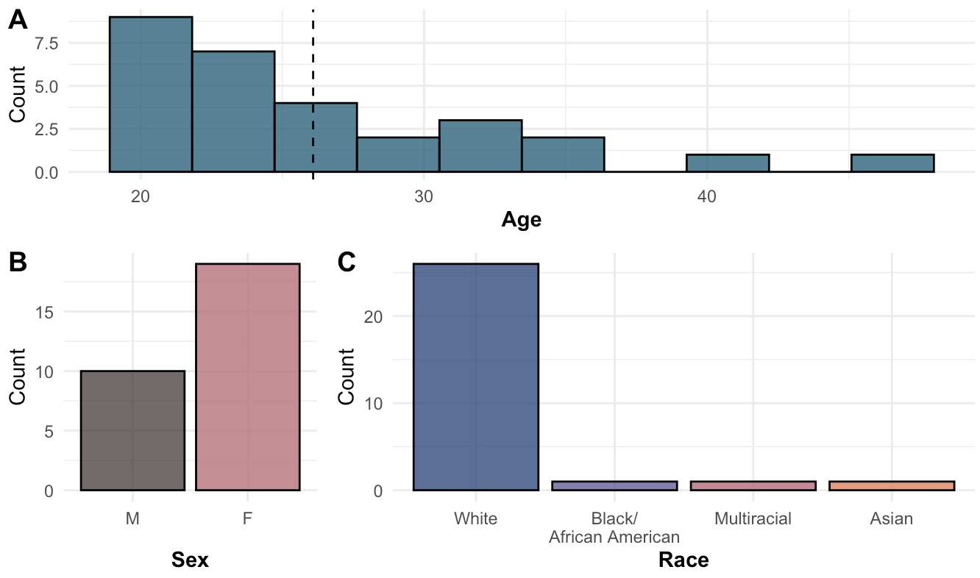
Demographics
Notes:
Age 19-45y (M = 26.2)
28 total participants w full data, 18 female
Small sample size, limited ability to detect small effects
Racial/ethnic homogeneity: Mostly White-identifying (~90%), 2 Black/African American, 2 multiracial, 1 Asian
My findings may have limited generalizability due to this demographic gap. This is particularly relevant because asthma disproportionately affects individuals identifying as Black NH, American Indian NH, and Multiracial NH ( CDC, 2023). The applicability of my relationships beyond this sample’s specific demographic may require further investigation.

Slide 30
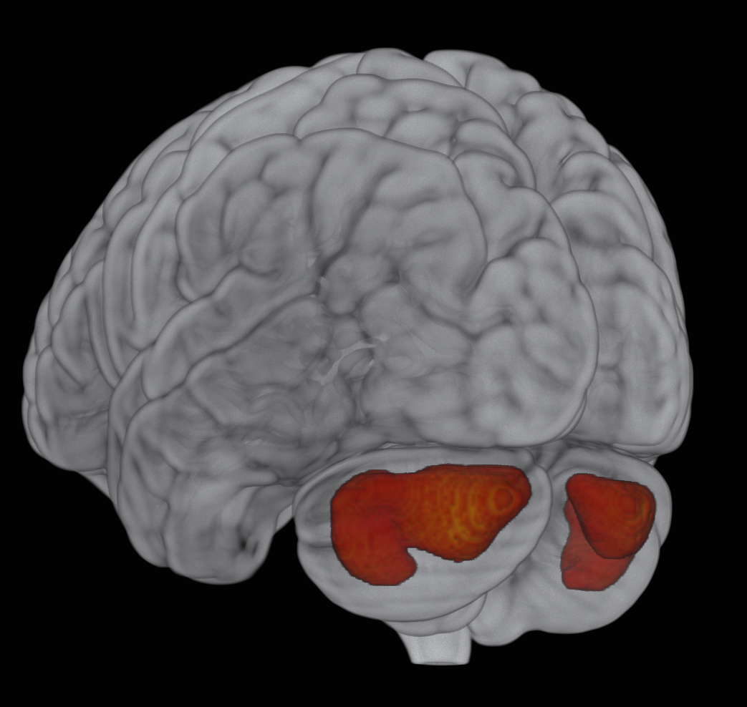
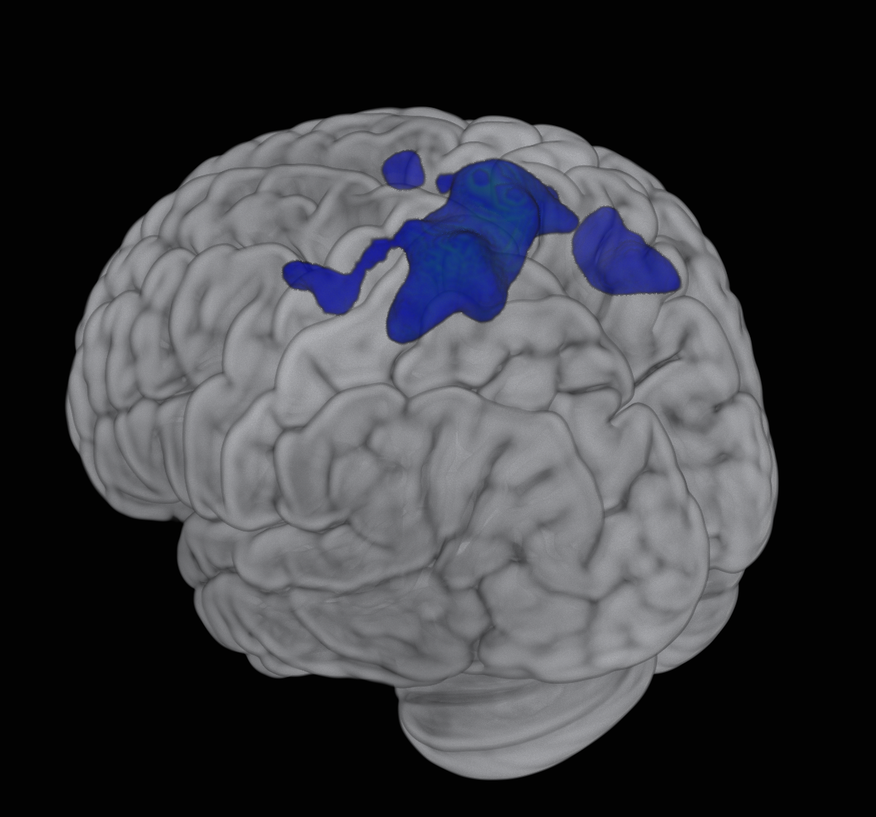
Is acute stress associated with brain activity?
Stress is associated with increased cerebellum and decreased motor / premotor cortex activity
p < .05 corrected
p < .05 corrected
(Nair et al., Brain Commun 2023; Pierce et al., The Cbl 2023; Rosenkranz et al., unpublished)
(Kalin et al., Biol Psychiatry 2005; Metz, Rev Neurosci 2007)
Notes:
Outside the salience network, glucose metabolism was altered in threat-related regions across the brain, in a pattern that may reflect a shift in how resources are allocated, to prioritize regions that promote energy mobilization
Stress was associated with increased glucose metabolism in the cerebellum,
a region traditionally known for its role in movement/balance, but which has increasingly been identified as being important in EMOTION/cognition; andshowing structural and functional changes in asthma
May also be involved in mobilizing energy/response to stress
In addition to widespread increases in glucose metabolism across the brain, Stress was associated with decreased glucose metabolism in the motor/premotor cortex. This pattern is consistent with a freezing response, characterized by less efficient motor planning and execution
Studies in non-human primates have correlated decreased motor cortex activity with freezing responses to stress
Taken together, this pattern suggests a more comprehensive profile of stress responses

Slide 31
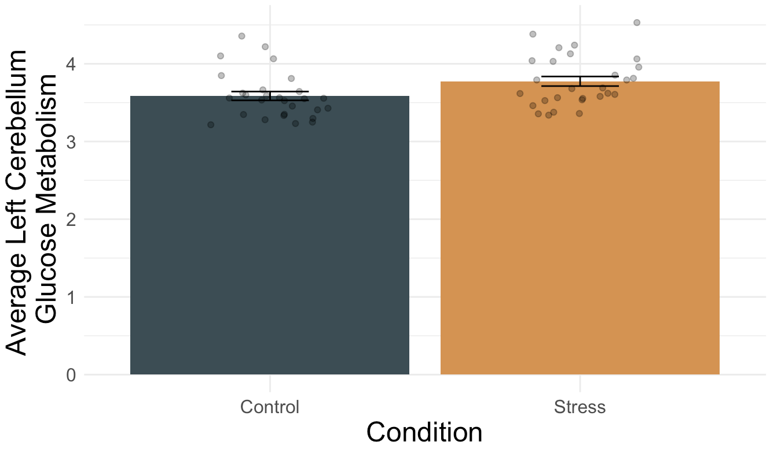
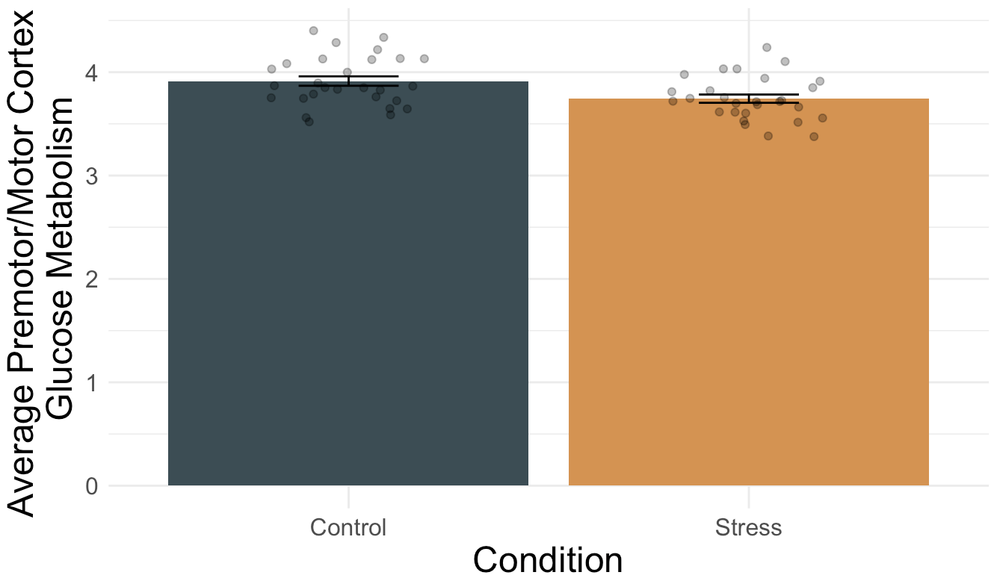
Is acute stress associated with brain activity?
Stress is associated with increased
cerebellum activity
R
R
L
Avg. L Cerebellum
Glucose Metabolism
Avg. Premotor/Motor Cortex Glucose Metabolism
Control Stress
Control Stress
(Baumann & Mattingley, NeuroImage 2012; Nair et al., Brain Commun 2023; Pierce et al., The Cerebellum 2023; Rosenkranz et al., unpublished data)

Slide 32
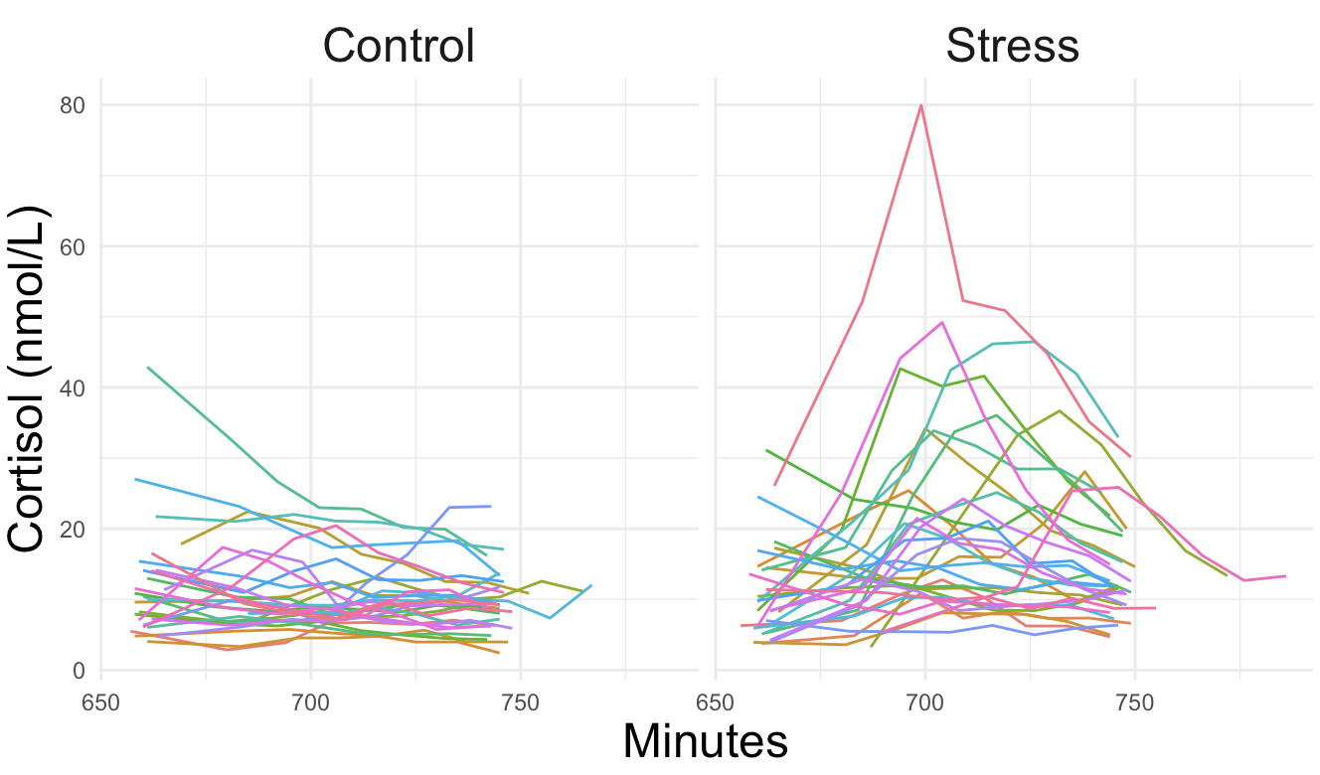
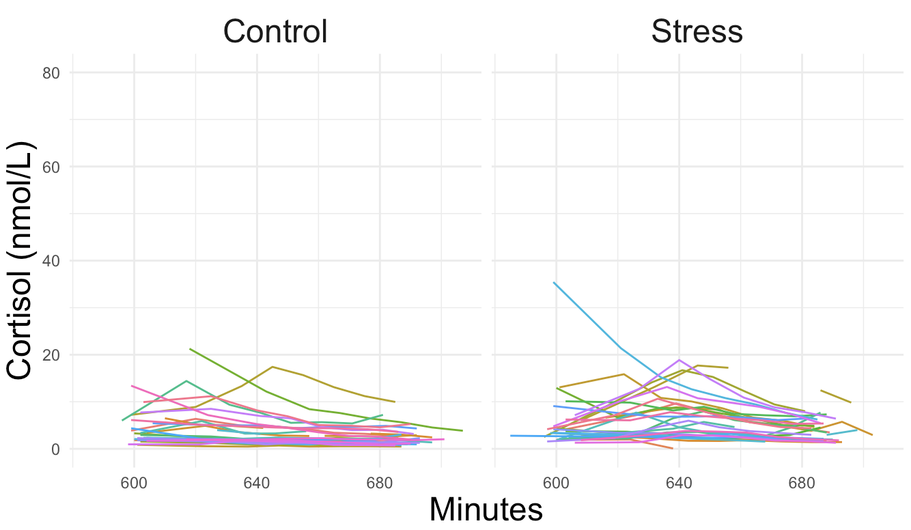
Why were there no effects of stress on airway inflammation?
Prior study
Less robust acute stress response
Sympathetic Nervous System moderation
Acute stress does not prime inflammatory response to allergen challenge in those with average (not high, not low) chronic stress
Current study
Notes:
Alternative explanations (why we didn’t find airway inflammation differences)
- this sample had a MUCH less robust response to acute stress (cortisol comparison) – ecological validity of stressor and variability in what ppl find stressful; also think about perceived threat individual variability
- SNS responses we didn’t measure could have moderating influences
- acute stress simply did NOT prime inflammatory responses to allergen challenge in this sample – chronic stress was moderate

Slide 33
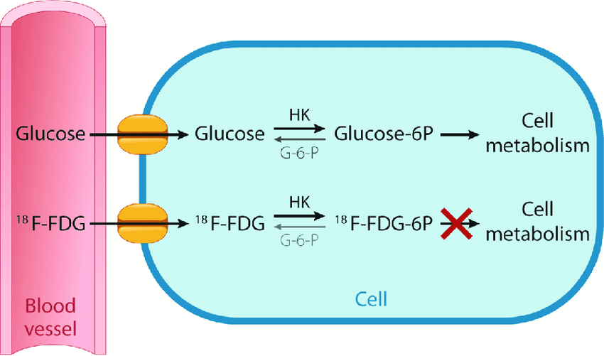
PET
Brain Glucose Metabolism: fluoro-18-deoxyglucose (FDG)-Positron Emission Tomography (PET)
Venous FDG injection →
[uptake time: TSST] →
Scan
FDG “trapped”
(Rahman et al., 2019)
Notes:
Brain glucose metabolism was measured by FDG-PET
where glucose is being metabolized in brain = more active
so the tracer (FDG) was injected but then it takes time for FDG to accumulate in brain tissue, which took place while participants did TSST
FDG gets trapped in metabolic cycle so stays in the regions it is in during the task: both enter the cell and are phosphorylated… glucose can be metabolized by FDG can’t so is trapped [next]
then they were scanned, and since the FDG had been trapped in the metabolic cycle, the neural activity detected DURING SCAN reflects events occurring over previous 30min

Slide 34
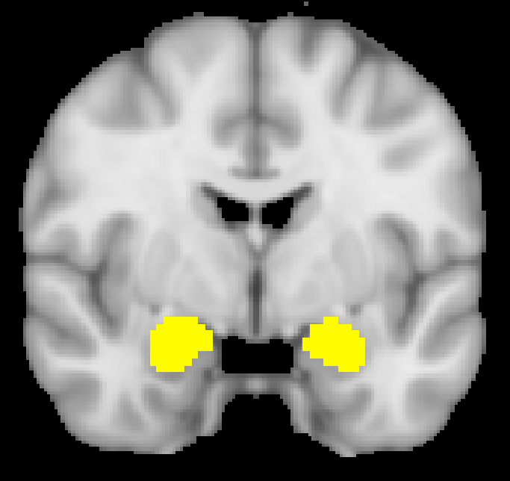
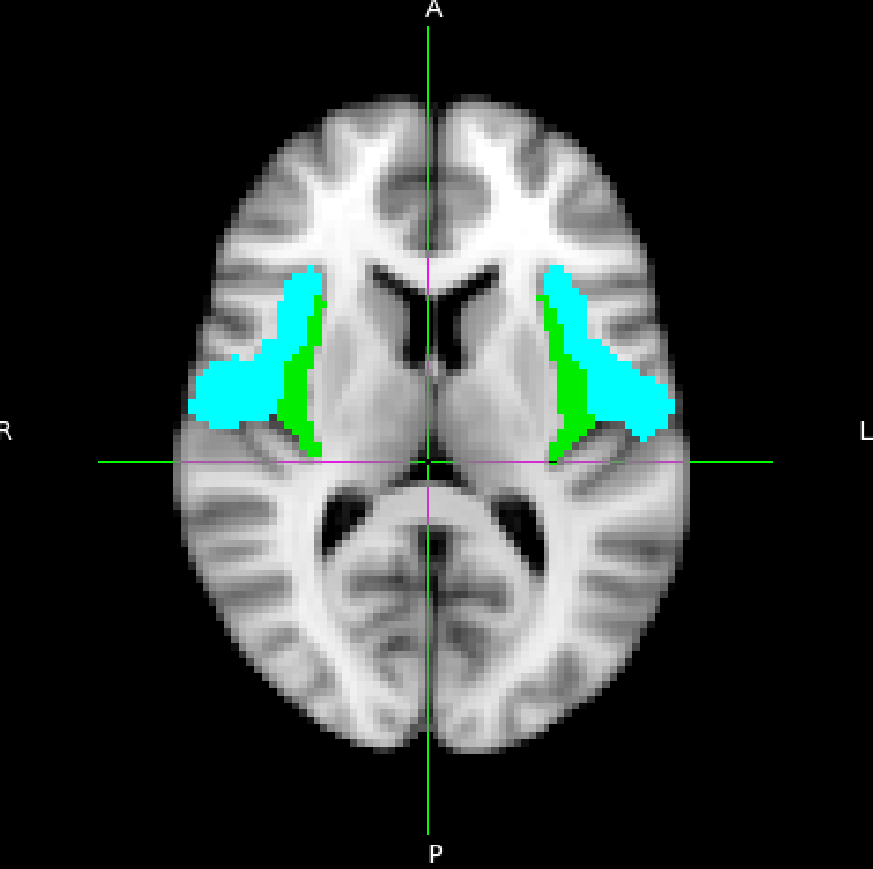
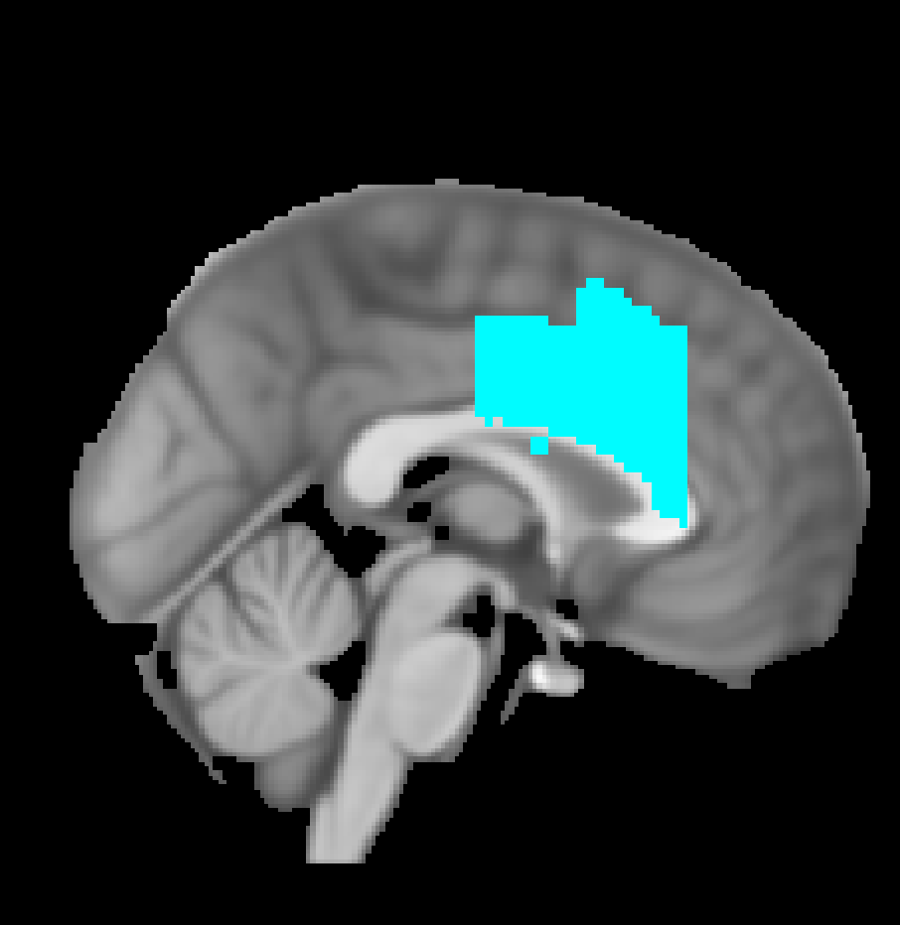
Analyses: Stress Neurocircuitry
Whole-Brain
+
a priori ROIs
amygdala, infula/frontal opercular cortex (IFOC), dorsal anterior cingulate cortex (dACC)
Paired t-tests with FSL’s randomise
Regressions with FSL’s randomise
PET image with cortisol and inflammatory biomarkers
Notes:
We did both whole-brain and region of interest analyses
ROIs selected based on our prior studies and literature implicating these regions in both emotion and immune [next]
Bilateral ROIs include: amygdala, insula/frontal opercular cortex (IFOC), dACC
Insula frontal opercular cortex, which I defined as a combination of full insula, frontal and central opercular cortex, and lateral OFC (medial boundary at the lateral-most insula coordinates) using Harvard-Oxford Atlas with a 25% probability threshold (6719 voxels)
dACC defined by Shackman et al. (4355 voxels)
We assessed relationships between stress neurocircuitry and cortisol response through Regressions with FSL's Randomise, regressing PET stress minus control diff images on Stress-minus-Control cortisol AUCg
[next] We also used Regressions using FSL's Randomise to assess relationships between stress neurocircuitry and airway inflammation [next]
These analyses regressed PET Stress-minus-Control difference image on Stress-minus-Control, post minus pre allergen challenge inflammatory biomarkers including
FeNO, sputum EOS [th2 pathway], IL17, IL1R1, IL23A [th17 pathway]
Adding antigen dose as a covariate to control for within/betw subj differences
Finally, we assessed relationships between stress neurocircuitry and baseline distress using
Regressions with FSL’s Randomise. PET stress minus control diff images were regressed on baseline distress (LSI and BDI)

Slide 35
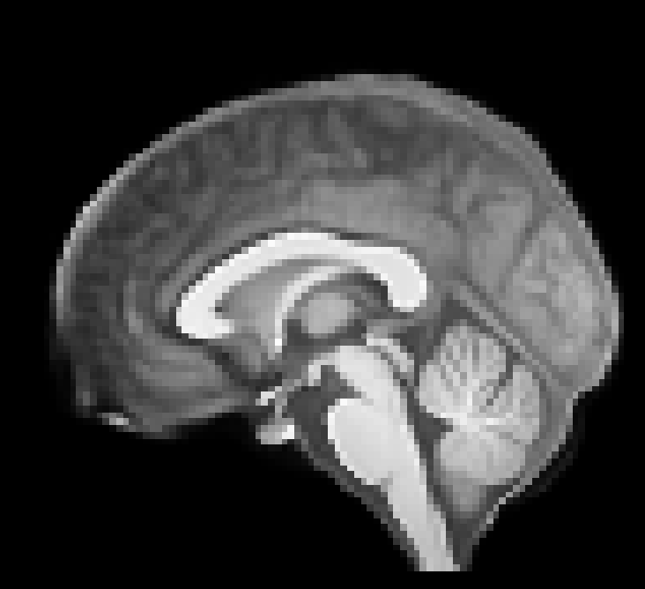
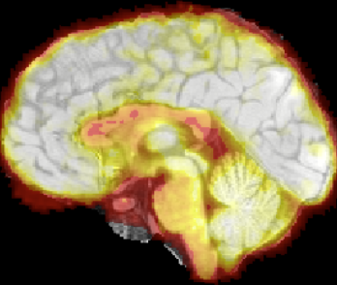
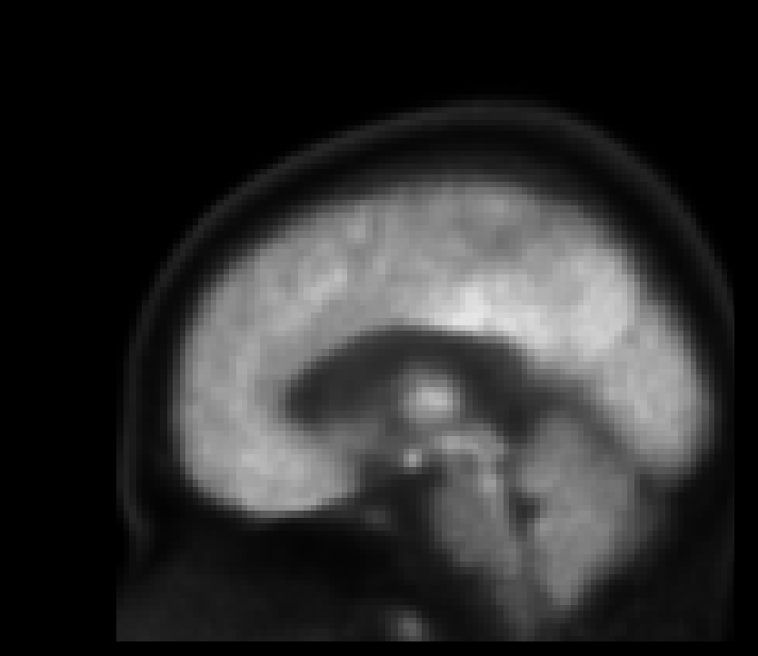
PET Processing
Processing pipeline optimized for PET-T1 co-registration
FSL’s FEAT; AFNI; ANTs
2 subjects missing T1; co-registered to PET template in MNI space
Study-specific T1 template
Example co-registration
PET template in MNI space
Notes:
Segmented image, smoothed GM mask, bias-corrected PET data, coregistered PET to smoothed GM mask
Scaled PET data using GM mask of T1
Create study-specific template of T1 images, normalize
Concatenate all transforms from individual subj space through MNI and apply to raw PET data, then smooth
1032 and 1088 had no T1 (MRI), so were coregistered to PET template in MNI space
Run analyses with and without these brains?
1013 questions about alignment and weird brain

Slide 36
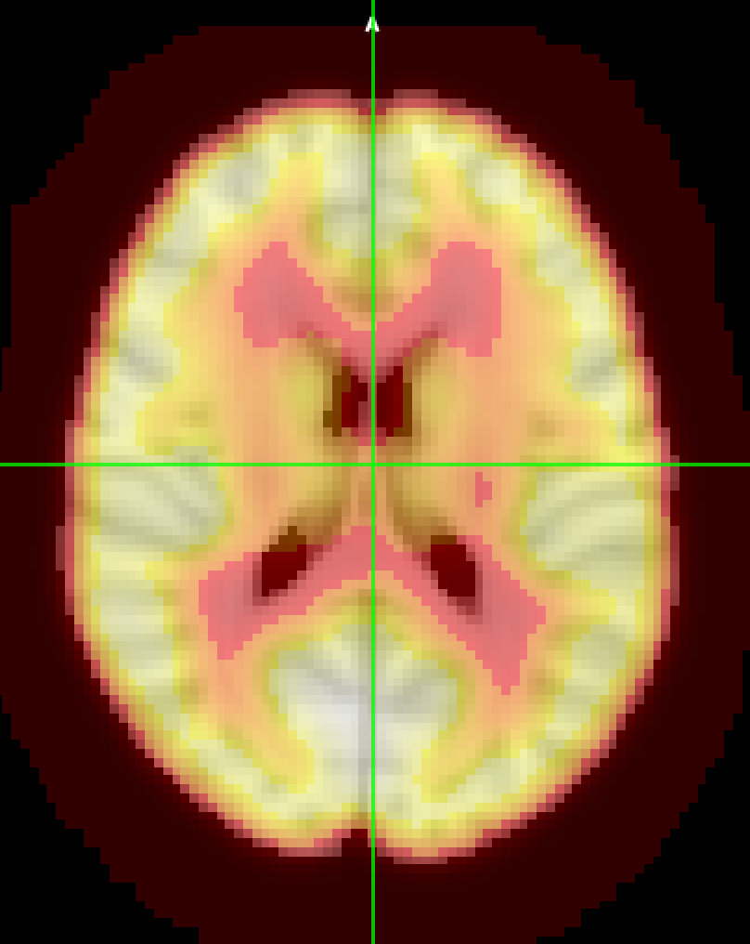
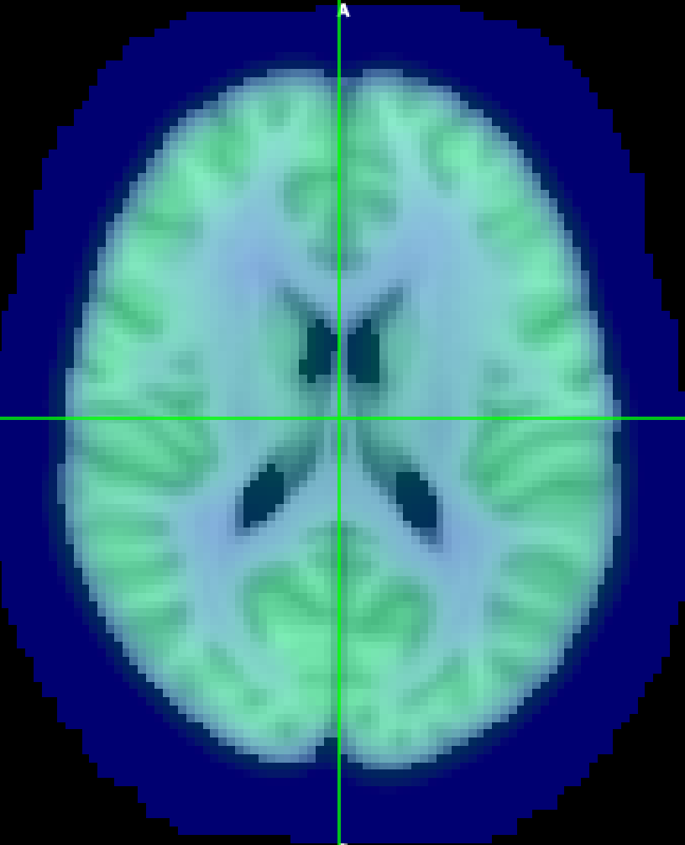
PET Processing
4D scaled, smoothed PET images co-registered to T1 template in MNI space: merge by condition
Stress minus Control
Stress
—
Control
Notes:
Stress minus control difference image:
For each condition (control and stress), I created a merged 4D file of scaled, smoothed PET images (co-registered to T1 templates) in MNI space – that’s what you see in these images
Then subtracted the control condition from the stress condition
So that inputs could be 0 and 1, where 1 = the difference image and if that contrast was significant, it means stress > control

Slide 37
Allergen challenge
Baseline FEV₁ & FeNO
Blood Draw
Allergen Challenge
Hourly FEV₁ & FeNO
4hr
Allergenic extract inhaled
(cat, dust, or ragweed)
Concentration increased until FEV₁ falls 20%
FEV₁ : Forced Expiratory Volume (1s) = Lung Function
FeNO: Fraction of Exhaled Nitric Oxide = Airway Inflammation
Notes:
After stress test and PET scan, allergen challenge – pulmonary staff were blind to challenge order
Start w baseline lung function FEV1 and FeNO [next]
allergen challenge where participants inhaled allergenic extract [cat, dust, or ragweed]
[next] subjects inhaled increasing concentrations of that extract until FEV1 fell by 20% compared to baseline [next]
Then, hourly FEV1 and FeNO for 4hr following challenge [next]
Final blood draw 4h post wlac

Slide 38
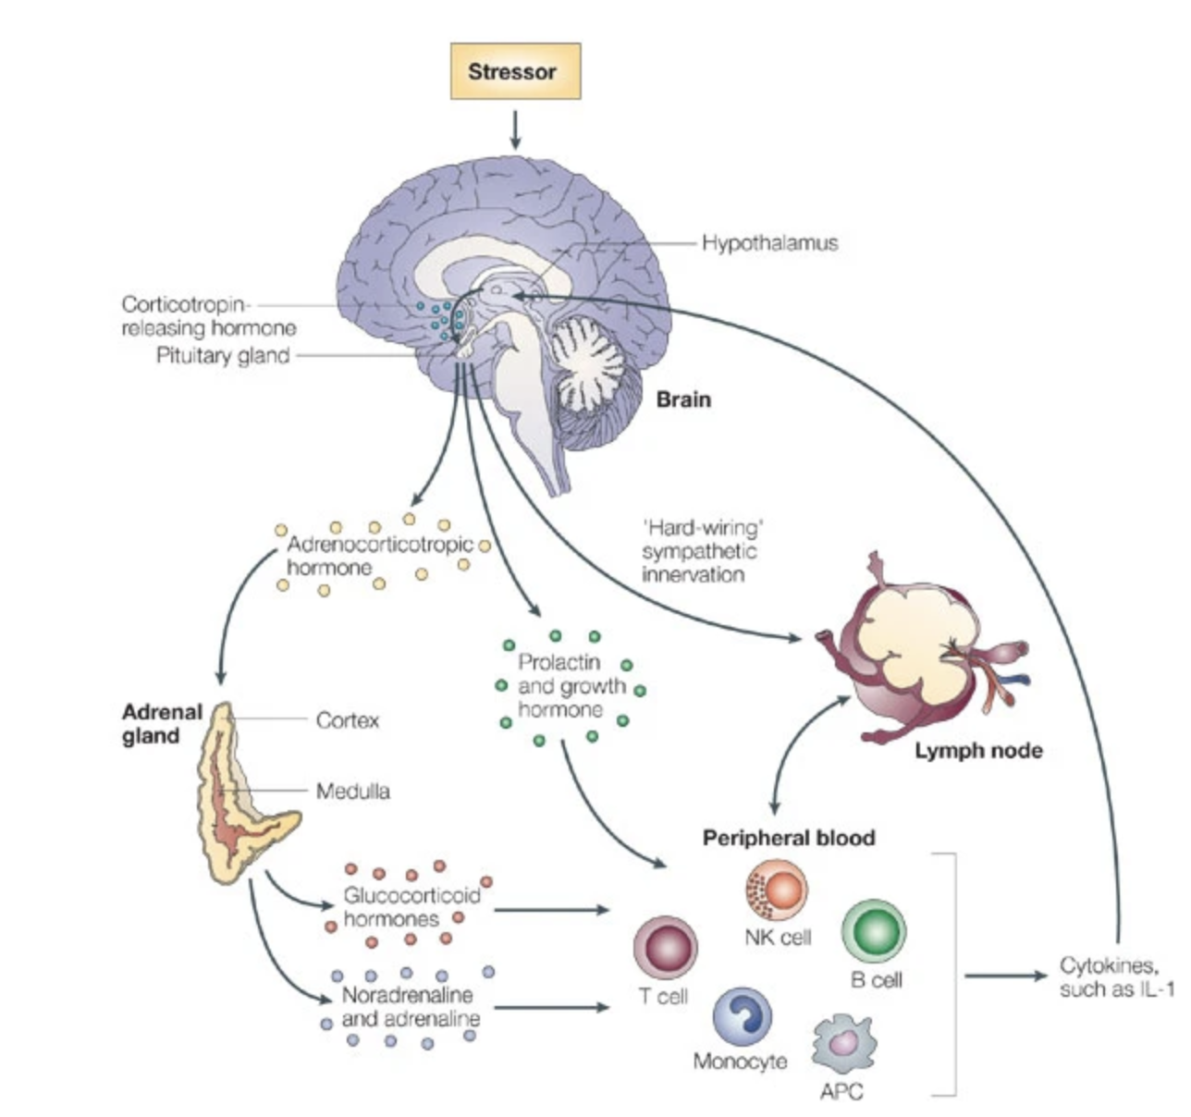


Proximal and distal mechanisms
Distal Mechanism: brain [glucose metabolism]
In-Between Mechanisms: brainstem
Proximal Mechanisms:
HPA Axis
Sympathetic Nervous System
Neurogenic Inflammation (Sensory Neuropeptides)
(Glaser & Kiecolt-Glaser, 2005)
Notes:
NOTE: there are several pathways between higher-level brain activity and ultimate immune expression. We are talking about the neural level of analysis and the inflammatory one; but there are multiple ways you could look at these relationships
Discussion of proximal vs distal mechanisms is warranted: if my hypotheses are supported, how does increased glucose metabolism actually lead to increases airway response to allergen?
Glucose metabolism in the brain, especially in emotion-related /cortical and subcortical regions, is a distal mechanism [next]
“In-between” mechanisms may include regions like the brainstem
These regions are linked to ANS control centers and HPA axis regulation
HPA axis: glucocorticoids impacting immune cells – suppress in short term, contribute to inflammation in long term (e.g., what we saw w chronic stress in first study)
SNS: innervation of lymph nodes; circulating catecholamines bias to promote asthma-related inflammation
Neurogenic inflammation via sensory neuropeptides
Glaser & Kiecolt-Glaser, 2005

Slide 39
Power: stress neurocircuitry
Sensitivity Power Analysis:
For 80% power (N = 27) at ⍺ = .05:
Medium Effect Size d = .56
Notes:
Quick note on sensitivity power analysis for an Independent samples t-test:
For 80% power with n = 27, alpha = .05:
We can detect a medium effect size cohen’s d of .56
Still figuring out the power analysis for regressions, and a solution for lmem power analysis

Slide 40
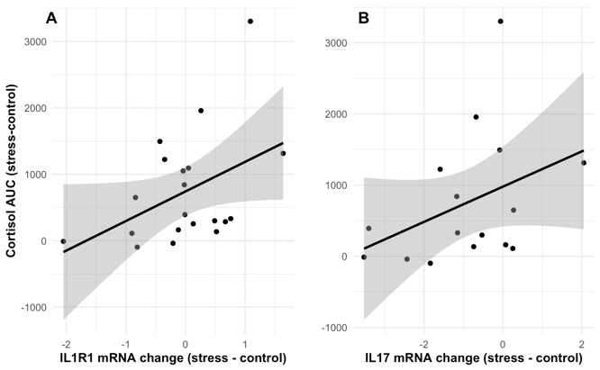
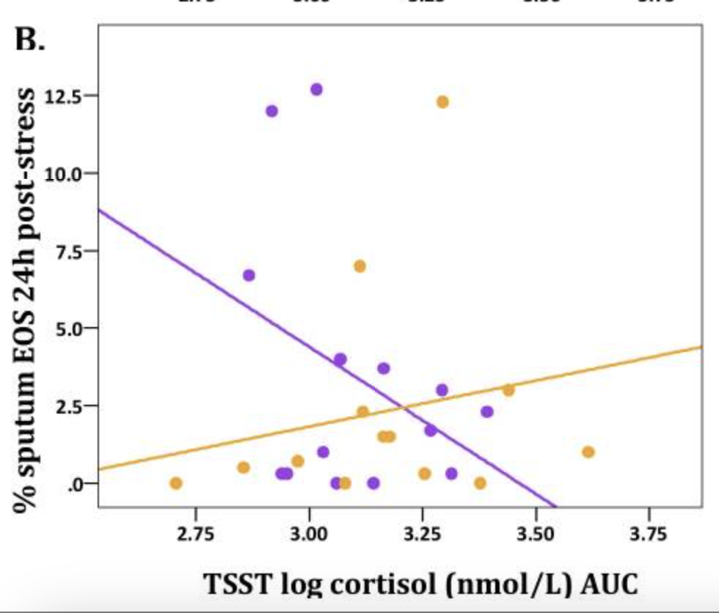

Prior evidence
Psychosocial Stressor ⟶ Increased Cortisol, associated with Airway Inflammation Biomarkers
Th17 path (IL-17A, IL-1R1) • Th2 path (EOS) moderated by chronic stress
greater airway
inflammation
(Rosenkranz et al., 2016)
greater cortisol
Notes:
Main motivation for this study came from our prior work implying the that a context of stress primes susceptibility to more severe inflammatory responses :
We found that a psychosocial stressor increased salivary cortisol, which was associated with airway inflammation biomarkers:
In the Th17 path, cortisol response to the TSST positively associated with expression of IL-17A and IL-1R1 mRNA in airway cells.
Note here this is mRNA, not actual protein expression: = body is prepared to respond
IL-1R1 = receptor for IL-1b
Inflammation in the Th2 path (eosinophils) was moderated by chronic stress levels, such that [next]
Cortisol response to acute stress and sputum EOS were POSITIVELY associated for those with high baseline chronic stress (yellow line), but negatively associated for those with low chronic stress (purple) [next]
Disparate effects of cortisol on airway inflammation, depending on chronic stress
Importantly, this was found in the absence of airway challenge! [next]
Higher chronic stress also associated with greater cortisol response to TSST

